Slide 1
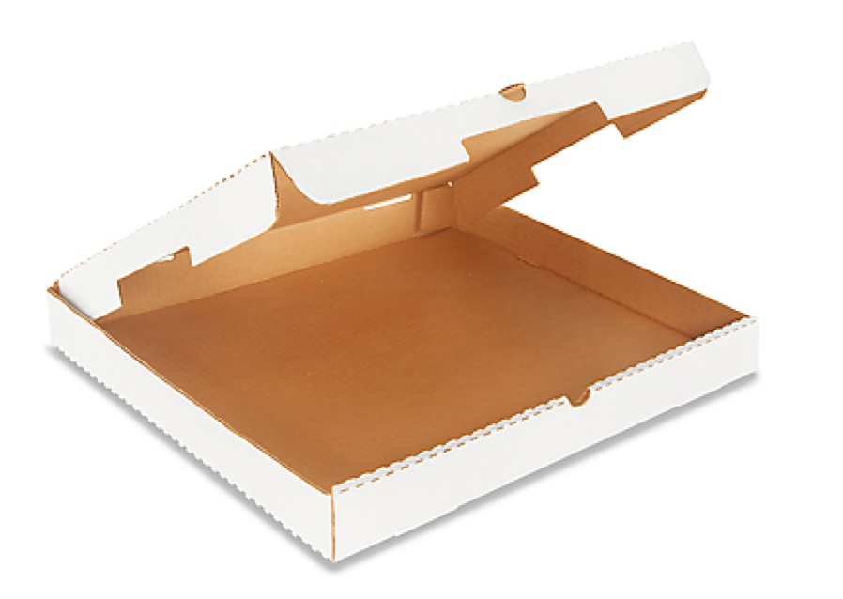
Sampling
PIZZA!
Determine the toppings you think are on the pizza based on your individual piece.
Compare your piece to your group, & determine the toppings on the pizza based on your group.
Notes:
Pizza box.
Do you want pizza?
Questions: What is on your piece of pizza? Would you buy the whole pie based on your piece of pizza? Why or why not?

Slide 2
Sampling
PIZZA!
Did your individual piece of pizza tell you everything that was on the pizza?
What did you learn about the pizza as you compared your samples to other people’s pieces?

Slide 3
Sampling
PIZZA!
How does your piece of pizza represent a sample of the whole pizza?
What is a scientific sample?

Slide 4
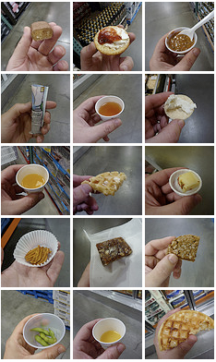
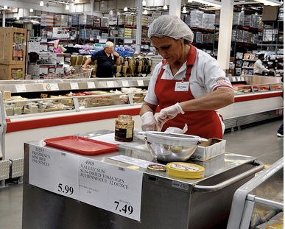
Sampling
What is sampling?
Notes:
Sampling is similar to the small food samples given out at Costco and other grocery stores. The food store may be trying to get you to buy an entire pizza by offering you a bite-sized morsel. You are assuming that the entire pizza will taste like the sample.
The more you sample, the more accurately you will be able to describe the larger area. For example, a pizza may have many different toppings. If you only sample it once, your small piece may only have one topping. If you did not know how many toppings were on the pizza, you would assume there was only one based on your sample. But, if you sampled the pizza many times, you would likely get a variety of toppings in your sample.

Slide 5
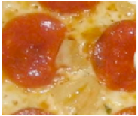
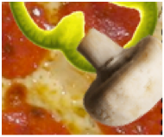
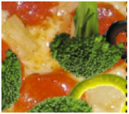
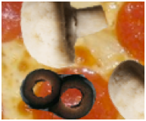
Sampling
Ecological sampling
Process by which small, representative sections of an area are used to estimate the composition, or properties, of a larger area
Representative sections = samples

Slide 6
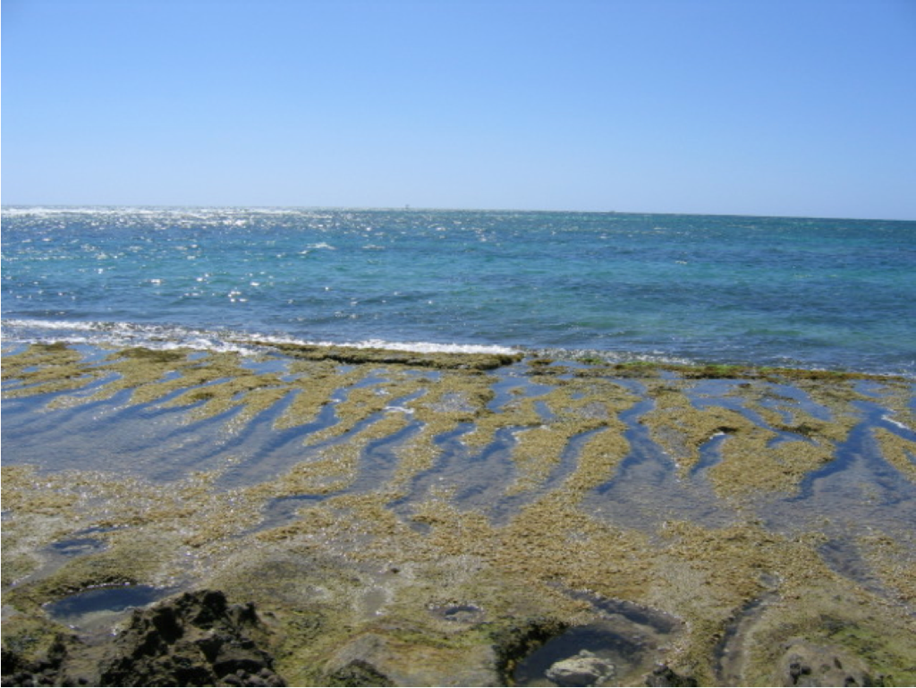
Ecological Sampling
Small portions of a community (samples) are representative of an entire area
The more you sample, the more accurately you can describe an area
Categorize an area without counting or measuring everything
Notes:
The small areas, or samples, must be representative of the larger area for these estimates to be accurate.
The more samples examined, the more accurately an area can be described.

Slide 7
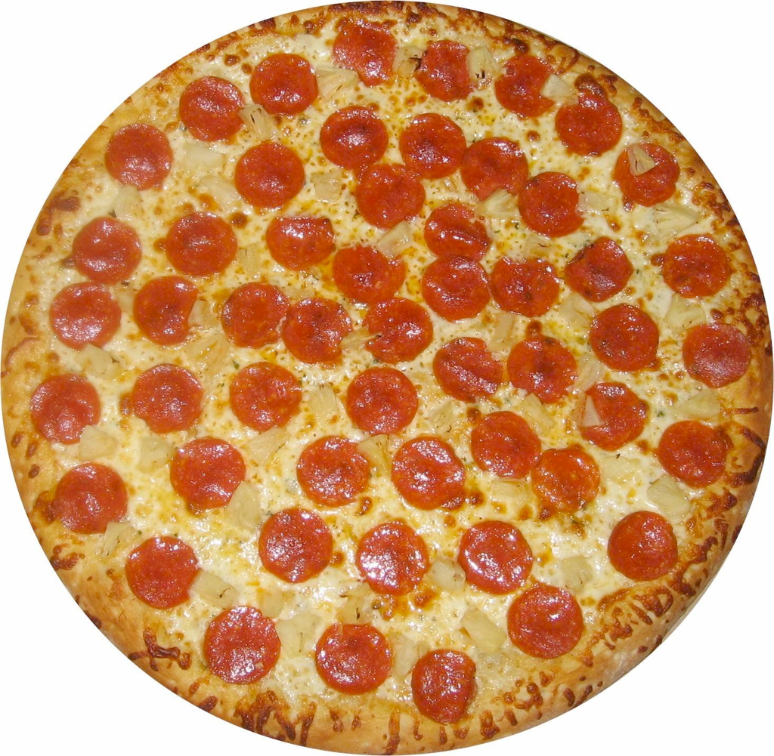
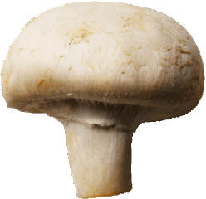
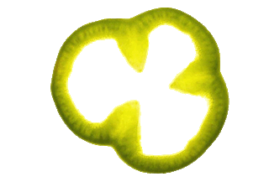
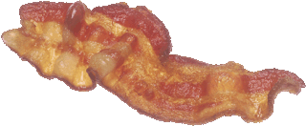
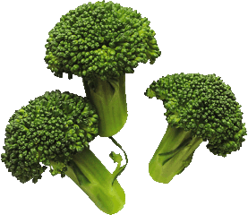

Slide 8
Sampling
Multiple Samples
No guarantee that any sample is perfectly representative
Therefore, we repeatedly sample = Replication
Notes:
need to analyze multiple samples before making conclusions
replication = repeated sampling

Slide 9
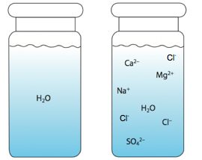
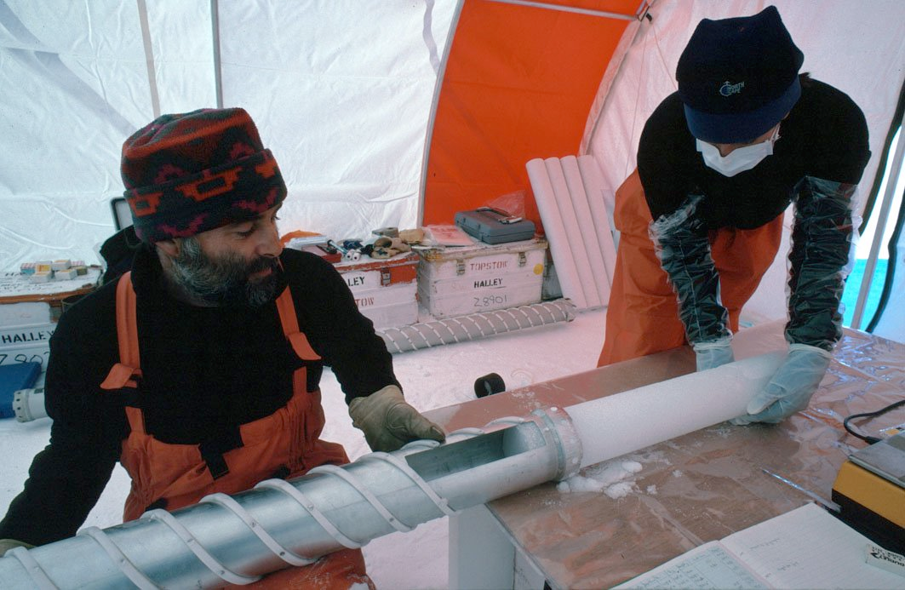
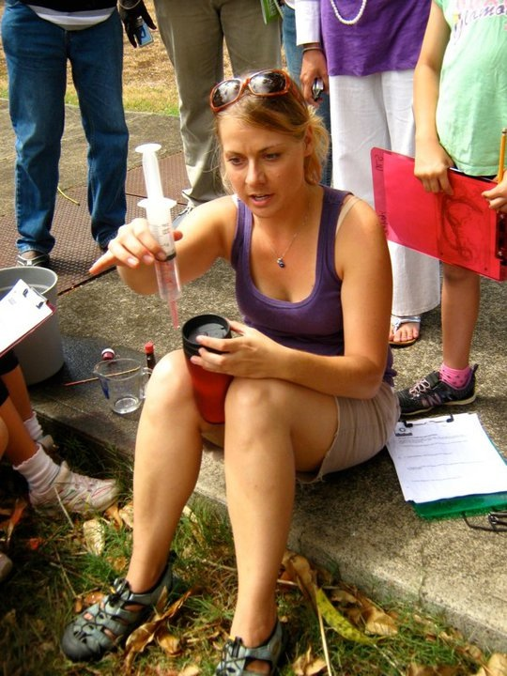
Sampling
Water samples, blood draws, ice cores, fin clips
Notes:
Sampling is a powerful tool that is important across many scientific disciplines.
The type of sample will depend on the discipline and on the task involved.
These are examples of sampling in different disciplines

Slide 10
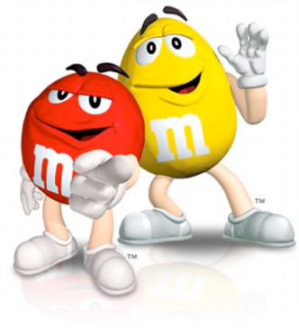
Sampling Design
Make predictions:
What colors are in the bag?
What color(s) do you think will be the most abundant?
What color(s) do you think will be the least abundant?
Why? (Hypothesis)
Notes:
(student predictions are important for buy-in)

Slide 11
Sampling Design
Standardized Sampling Scheme
How many objects?
How will you collect?
How ensure random samples?
What if you collect more than set sample size ?
Notes:
Do as a class - class consensus. Each member of the class should take one sample.
If possible, encourage 10 M&Ms per sample (makes math easy)

Slide 12
Sampling Design
Record data in data table.
Notes:
Questions (repeated on next slide) to ask as you start to look at data with your class:
What can you infer about bag from your sample?
How does your sample compare to other classmate’s samples?
What can we infer about the colors in the bag if we stop our data collection at this point (e.g. after 3 samples)?
What might we observe as we add more samples to the data table?
You want students to understand the importance of taking many samples. The first few samples usually do not result in the same proportions as does the full data set.
AVERAGE --> 10, PROPORTION --> 1, PERCENTAGE --> 100% (only need to focus on average and percentage, proportion optional extension)
Note that many individual samples do not reflect the proportions in the bag very well. But when all the samples are averaged together, the proportion of the bag is evened out. Thus the more we sample, the more accurate our data. This demonstrates the power of replication.

Slide 13
Sampling Process
What can you infer about bag from your sample?
How does your sample compare to others?
What can we infer about the colors in the bag if we stop our data collection at this point (e.g., after 3 samples)?
What might we observe as we add more samples to the data table?
Have your predictions changed?
Notes:
Allow changes to predictions. This emphasizes that it is OK if hypotheses change over time as more information is gathered

Slide 14
Sampling Conclusions
What color(s) were the most abundant?
What color(s) were the least abundant?
How does this fit with your hypothesis?
How accurate was our sampling survey?

Slide 15
Sampling Design
m&m Color | Number in bag | Number in samples
Red | 174
Orange | 303
Yellow | 308
Green | 328
Blue | 132
Brown | 86
Yellow
Total M&Ms in bag = 1331, Total M&Ms sampled =____
Notes:
This is the number of M&Ms in the bag you sampled from (YOU NEED TO CHANGE TO THE NUMBERS IN YOUR BAG)

Slide 16
Sampling Design
m&m Color | Bag Percentages | Sample Mean Percentages
Red | 13.1%
Orange | 22.8%
Yellow | 23.1%
Green | 24.6%
Blue | 9.9%
Brown | 6.5%
Yellow
(total percentage = 100%)
Notes:
This is the percentage of M&Ms in the bag you sampled from (YOU NEED TO CHANGE TO THE NUMBERS IN YOUR BAG).
It is easier to compare percentages than raw numbers.

Slide 17
m&m Sampling
Artificial - can count whole population in bag
Bag is subsample of the factory
Notes:
The M&M bag is itself a sample of all the M&M’s produced at the factory. While the students sampled one bag many times, they only sampled the “entire population” of M&M’s produced at the factory once. Thus, the class activity was really sub-sampling a sample.

Slide 18
Sampling Design
m&m Color | Percentage in bag | Percentage Produced*
Red | 13.1% | 13%
Orange | 22.8% | 20%
Yellow | 23.1% | 14%
Green | 24.6% | 16%
Blue | 9.9% | 24%
Brown | 6.56% | 13%
Yellow
*February 2012
Notes:
This is the percentage of M&Ms in the bag you sampled from (YOU NEED TO CHANGE TO THE NUMBERS IN YOUR BAG) compared to the percentages produced in factory (right column) as of Feb. 2012.
Chance factors involving the machines used by the manufacturer introduce random variation into the final color proportions of each bag produced. Some bags will have a distribution of colors that is close to the proportions produced by the factory, while others will be further away.

Slide 19
m&m Varieties
Notes:
(As of Feb. 2012) – Different M&M varieties are produced with different proportions of colors!

Slide 20
Sampling Design
What would happen if you choose your favorite colors when sampling?
What are the sources of error in this activity?

Slide 21
Error
Error
Differences between observed values and what is true in nature
Causes results that are inaccurate or misleading and can misrepresent nature
Random vs. Systematic
Random - EQUAL chance of selection, need replication
Systematic - consistent difference from true value, one form of bias (often limitation of instruments or procedures)
Cannot completely eliminate
Reduce by being aware of common sources:
Instrumental, Environmental, Procedural, Human
Notes:
When a single measurement is compared to another single measurement of the same thing, the values are usually not identical. Differences between single measurements are due to error.
Systematic error not always bias - not always human error

Slide 22
Accuracy vs. Precision
Accuracy
How close measurements are to the true value
Precision
How close measurements of the same item are to each other
Notes:
Two ways to think about errors - accuracy and precision

