Slide 1
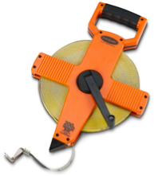
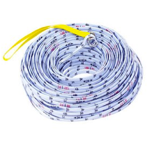
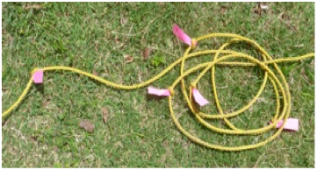
Sampling for Abundance
A transect line is a line of known length marked at regular intervals
Notes:
A transect line can be a physical item that is purchased commercially (e.g., transect tape or surveyor’s tape from forestry suppliers)
But - can also be marking regular intervals on a piece of rope (e.g. flagging tape).
A transect line can also be an invisible line between two points. For example, ships can sample along an invisible transect line across the ocean using maps and GPS.

Slide 2
Practice Sampling
The different colored circles represent different organisms
The empty white substrate represents sand
Which category do you think is most abundant? Least?
Notes:
To practice surveying/describing site = use circle mock study site on presentation slides as a model (blanket with “organisms” also a model).
Unusual as omnipotent (we are god!).
In ppt model… circle = organisms, substrate = sand.
Circles are not moving. Neither are cards/craft sticks. Thus these are benthic (bottom), sessile (stationary) organisms.
Not unrealistic model… fish do not tend to stick around in intertidal!
Questions: Which category do you think is the most abundant? Which is the least? Why?
Hypothesis. Abundance = how rare or common something is in our defined area. Abundance = AREA (not number). [Count = richness]
At some point during activities – cover categories (e.g., males, females, juveniles, adults) – are all index cards same? Are all blanket colors same?

Slide 3
Census vs. Survey
Census
Collect information about every single item interested in studying
Survey
Examine and describe area using samples
Notes:
Census = COUNT everything = time consuming, costly… and still misses things (think US census, misses population like illegal immigrants, homeless)
Survey = using samples to examine and describe area
Census → not as powerful as survey. With good sampling design and analyses, can analyze samples statistically, can estimate and infer things.

Slide 4
Transects
Lay a Transect
Notes:
Divide into groups of three... each group gets transect. This is a transect... GIVE NO DIRECTIONS... lie your transect in environment....
Students will probably do a variety of things with the transects. Whatever pattern evolves is OK and a good indication of prior knowledge.
Questions:
What do you guys think of this positioning of our transects? Do you like or not like? Why?
Why did you put it this way?
Point out things like:
If transects cross (spider-web)… could hit the same thing multiple times.
Meters vs. feet
0 point at one end of transect (in water to protect transect)
Standardize length & positioning (perpendicular to “water” to catch “zonation”)
Now ask students to coordinate... and see what they want to do... Try to get them to standardize

Slide 5
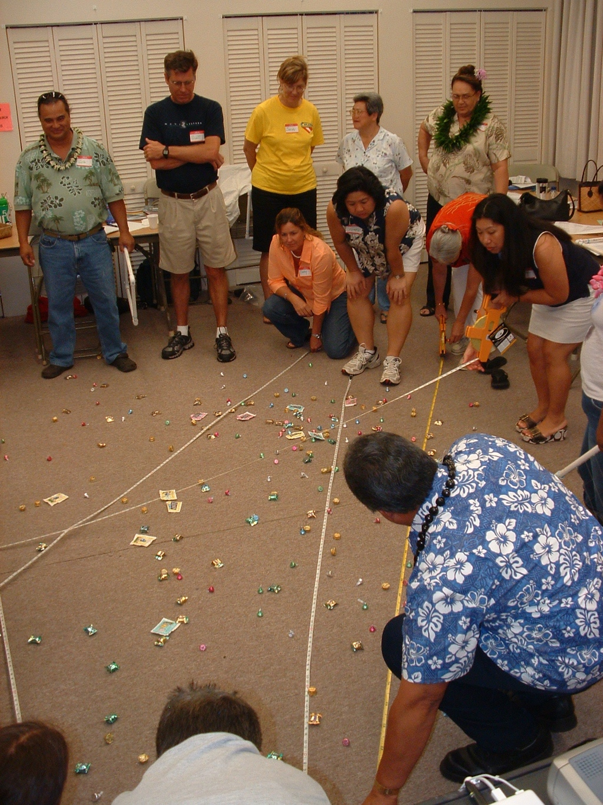
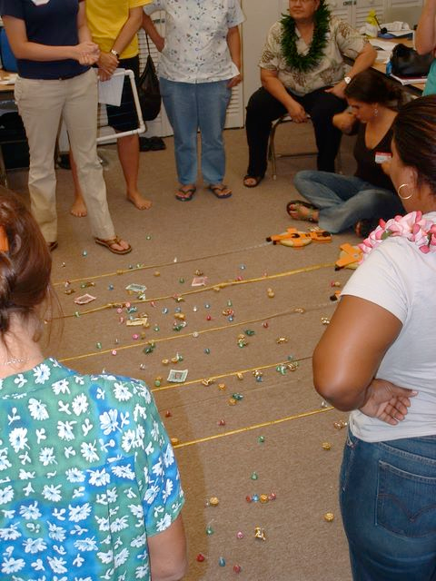
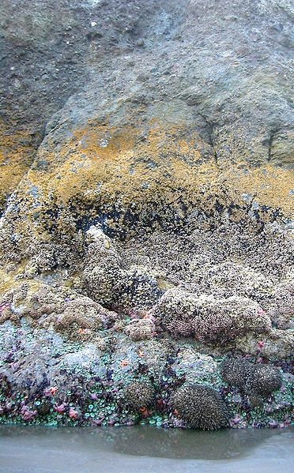
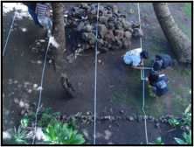
Transects
“0” marks on transects should all be in same direction
Transects should all have the same side of the tape facing up (metric)
Perpendicular transects if Ecological Zonation (distribution of organisms into “bands” based on varying biotic and abiotic factors)
Notes:
Only go to this slide after they correct coordinate their transects. Let them struggle first!
(Same points as previous slide, if have not already covered):
If transects cross (spider-web)… could hit the same thing multiple times.
Meters vs. feet
0 point at one end of transect (in water to protect transect)
Standardize length & positioning (perpendicular to “water” to catch “zonation”)
Question: How often should we take data points (transect point-intercepts) along our transect lines?

Slide 6
Random vs. Systematic Survey
Random
Random points (e.g. along transect)
Systematic (regular)
Transect points a set distance apart
BOTH valid, choice depends on goal(s)
T
Notes:
Random = unpredictable/unknown. Every area equal chance of being sampled, but run risk of, by chance, all sampling points in one area (e.g., just high tide).
In OPIHI, look at systematically so can capture high/mid/low intertidal areas.
Note: monitoring = time commitment - look at same area over time, important to characterize location in same way

Slide 7
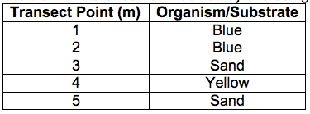
Transect Point intercept
Systematic
Notes:
One of the simplest ecological sampling methods is point-intercept transect.
Describe method: Record what is directly under a point. Can use tool (like skewer) to help. Only record what is on the top (vs. layering, where would record what all the layers are).
Record what is directly on top of point. Go through circle example. See that even though red was very close to transect point #5, we still record “sand” on our data sheet.
Transect got two of four species.
Decide as class (or you may decide beforehand) how often to take data points along their transect (e.g., every meter or half meter).

Slide 8
Transect Point intercept
How did you categorize the substrate and “organisms” in this area?
Substrate - substance on bottom on environment
What are pros of transect point intercept? Cons?
Sessile - stationary or immobile organisms
Benthic - organisms that live close to, or attached to, the bottom
Notes:
Question: Who filled in information at the top of the datasheet?
What is the importance of the information at the top of the transect data sheet (start and end times, location, date, transect line number)?
This is metadata. Important for understand when/where collected information and for sharing with others. Transect line number = when looking to ocean, #1 is on far left).
These are some good definitions to know if you have not gone over them yet.
Question: (if have not addressed already) What did you guys call things?
Go over importance of standardizing organism and substrate categories (this will be true in field as well).
Question: Who captured the most common “organism”? The least?
Question: What are the pros and cons of this method?
PRO = can sample quickly, accurate, easy to replicate (so, good for large uniform areas)
CON = misses a lot of stuff!

Slide 9
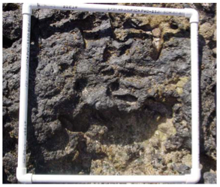
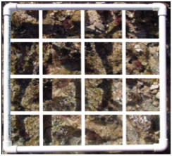
Quadrats
A quadrat is a area of known size and dimensions, generally square, often with string that divides the area into a set number of squares
Notes:
A quadrat is a framed area of known size and dimensions. Quadrats are generally square and often have string that divides the area into a set number of squares.
A frame can be made using PVC pipes, wire, cardboard…
The OPIHI quadrat is ~1/3 m square… kinda big for this (mock classroom) environment. We’ll be using a smaller quadrat.
More complex/smaller stuff = smaller quadrats.
The size of quadrat is dependent on the size of what you want to sample.

Slide 10
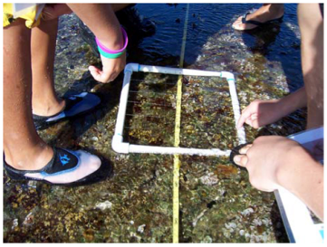
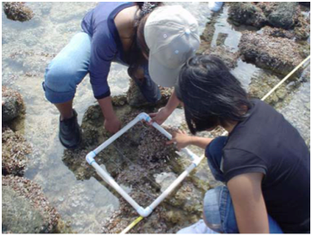
Placing Quadrats
Notes:
Quadrats are placed at designated points along the transect to get detailed information about a study site.
Quadrats should always be placed the same way in relation to the quadrat.
It does not matter where the quadrat is placed as long as the placement is the same for the entire class.
Question: How do you want to place our quadrats?
As long as everyone agrees, it does not matter how place as long as everyone consistent. However, keep in mind that although it might be easier to remember to always place the quadrat right over the transect point, the transect tape might obscure some organisms.

Slide 11
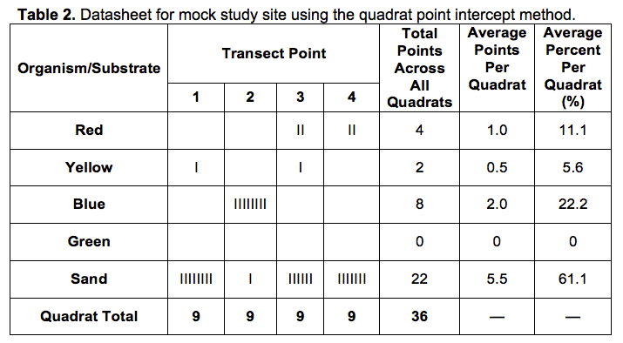
Quadrat Point intercept
Notes:
Place a quadrat with intersecting lines along pre- determined points on the transect line and record what is underneath each intersection within the quadrat frame. This method is similar to that used with the transect, but there are multiple intersections within the frame to be counted.
Doing this increases our sample size as getting so many more data points. In OPIHI, we will need to get 25 quadrats in the intertidal on each field trip.
GO THROUGH THE TABLE (so students understand how to fill out).
Categories in 1st column, transect points in other columns.
Since there are nine intercepts (in middle, if do not use edge of quadrat), the total in each column should add up to nine.
CHECK NUMBER of points before moving to next transect point.
In the circle study site, the quadrat point-intercept method has allowed us to record three of the four species at this site, but we are still missing green, it is so small it has never occurred under an intercept.

Slide 12
Quadrat Point intercept
What are pros and cons of this quadrat method?
Notes:
Question: Ask if anyone captured the more rare/small organisms.
Quadrat Point-intercept:
PRO = Captures more information, still accurate, easy to replicate
CON = takes more time, still misses stuff

Slide 13
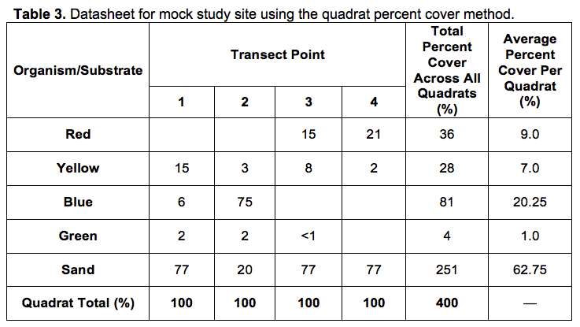
Quadrat Percent Cover
Notes:
In the quadrat percent cover method, you estimate and record the percentage that each organism takes up within the quadrat.
You do not need to pay attention to the intercepts inside the quadrat, although they can be useful reference points to help with estimation of percent cover (see squares modification).
A helpful tip when using the quadrat percent cover method is to imagine all the organisms of one species pushed into a corner of the quadrat and estimate what percentage of the quadrat they take up. It is often easier to start with the rare organisms and rare substrate and finish with the most common organisms and substrate.
The total percent in each quadrat column should add up to 100. Note that species that occur in less than 1% of the area are not considered in the total.
Take quadrat percent cover information at the same transect locations as the point-intercept method so we can directly compare each of the methods. In the field, you would take these methods at the same time.

Slide 14
Quadrat Percent Cover
What are pros and cons of this quadrat method?
How would you compare and contrast all of the methods?
Notes:
Quadrat Percent Cover:
PRO = captures EVERYTHING in quadrat
CON = takes MOST time, estimation error (uncertainty - larger degree of error)
Best for looking at small areas when want to capture all organisms in area

Slide 15
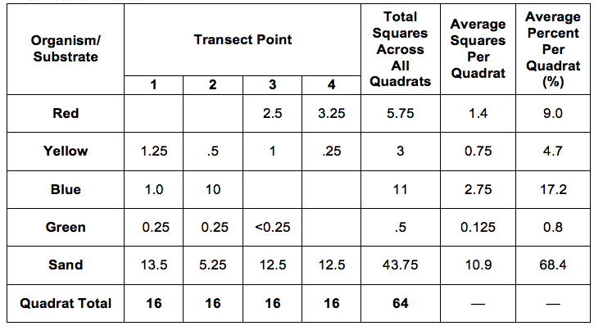
Quadrat Percent Cover
Squares Modification
Notes:
Only show if going to use this modification to percent cover

Slide 16
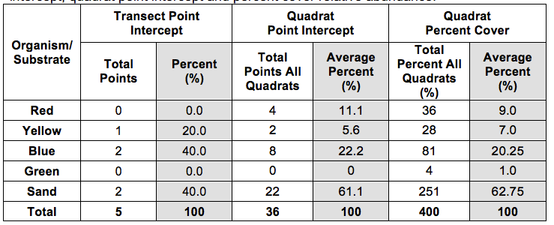
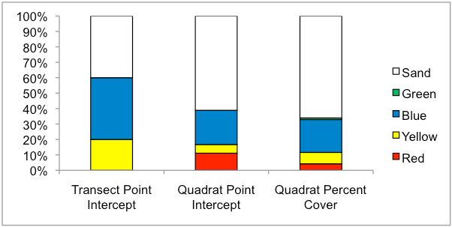
Descriptive Statistics
Relative species abundance =
Relative proportion of species
Graphs
Notes:
The relative representation of species in a location refers to how rare or common a species is relative to other species in a defined area or community. Relative species abundance is often displayed as the number of species or the percent cover of each species in a sample.
Calculating relative species abundance from transect as well as from quadrat point intercept and quadrat percent cover methods allows direct comparisons between methods.
What does this graph tell you?
Quadrat percent cover captured all species
But.... tell you which is best method? No.... depends on goals

Slide 17
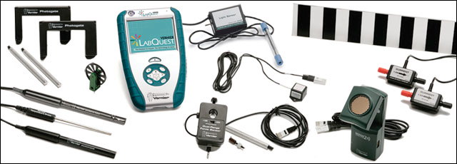
Integrating Physical and Chemical Parameters
Salinity, temperature, turbidity, DO
Come up with a sampling plan
Notes:
You can use small objects (e.g., cups) to represent different water quality measurements and talk about how students would sample their mock environment.

Slide 18
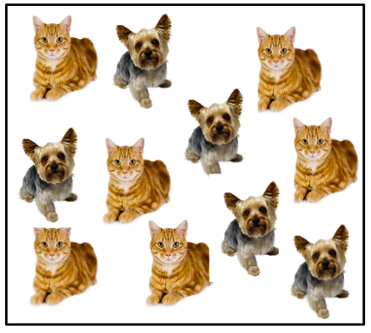
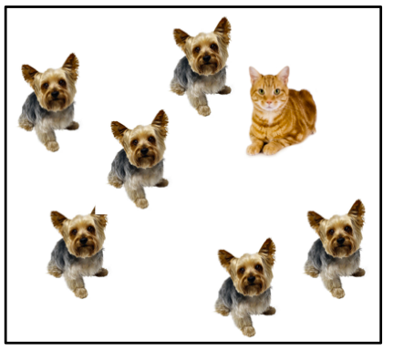
Biodiversity
Species Abundance (this activity) - relative representation of a species in a particular location
Species Richness - count of the number of different species in an area
Notes:
Richness in both squares is the SAME, Abundance in 1st MORE

Slide 19
Biodiversity
Species Evenness
Relative similarities of species abundances in an area
Species Diversity
BOTH species richness and abundance
Biodiversity
Variety of life between species (species diversity), within species (genetic and molecular diversity), and variety of life between regions (ecosystem diversity)
Notes:
Evenness = more even in top square

