Slide 1







Our Project In Hawai‘i’s Intertidal OPIHI

Slide 2
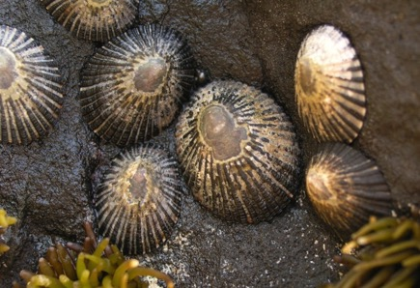
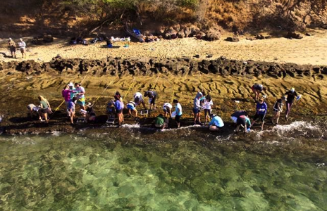
Picture by Joanna Philippoff
Picture by Ross Langston
‘Opihi vs. OPIHI
Notes:
‘Opihi = culturally important limpet, a type of snail, in Hawaii.
OPIHI, stands for Our Project In Hawaii’s Intertidal. The acronym was chosen, in part, because opihi limpets live in the intertidal, where this project centers.

Slide 3
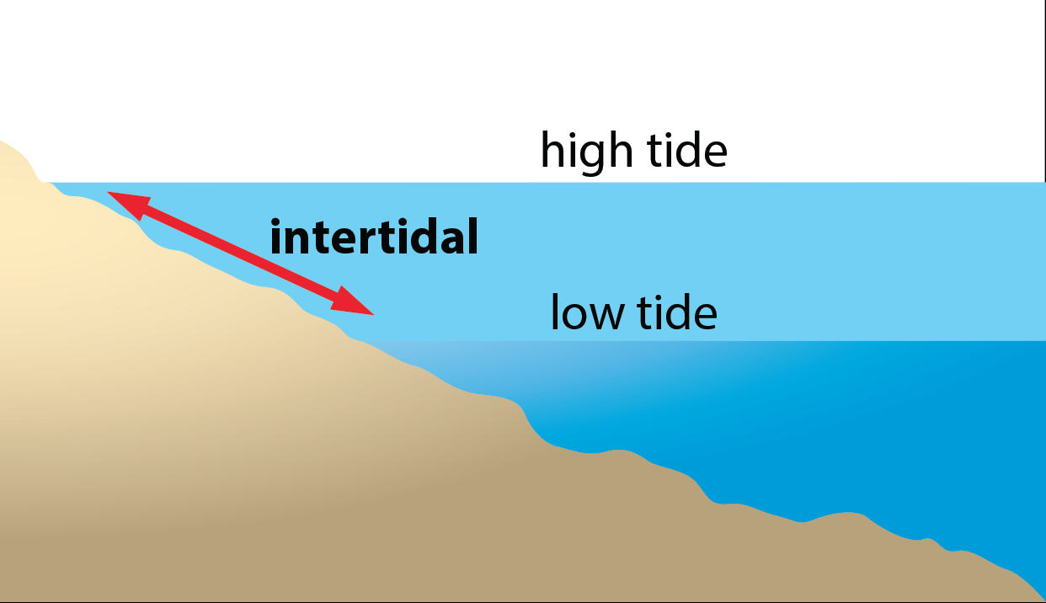
Intertidal = Ecological Zone
Image by Byron Inouye
Notes:
The intertidal is a marine ecosystem that is covered with water during high tide and exposed to air during low tide.
Tides are predictable daily rises and falls in the surface water of the ocean and large lakes.
Question: What do you think the tidal height is in Hawaii?

Slide 4
Tidal heights determined by position of sun and moon relative to earth
+ 3
+2
+1
0
-1
-2
-3
Water covers shore
Tidal Height (feet)
Shore exposed to air
When tidal height positive water covers shore.
When tidal height negative shore exposed to air.
Image by T. Erin Cox
Notes:
Tides are actually waves. A high tide is the stage when the tidal crest arrives at a particular location on shore, raising the sea level.
A low tide is the stage when the trough arrives, lowering the sea level. The vertical distance between high tide and low tide is the tidal range.
Tides are predictable because they are produced by a combination of gravitational forces between the earth, moon, and sun, that are predictable.
However, the tidal range and thus size of the intertidal area can vary dramatically based on a host of factors like the tilt of the earth, the location in orbit of the moon around earth and the earth around the sun, wave action, and geographic factors like coastline and seafloor features.

Slide 5
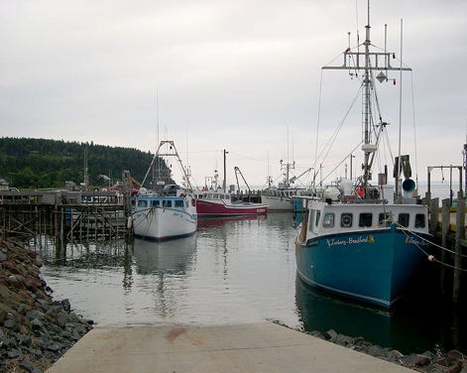
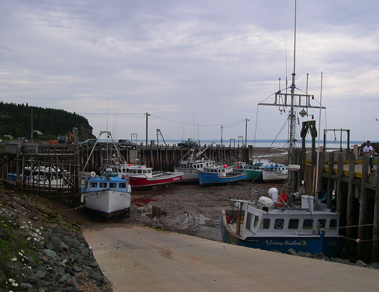
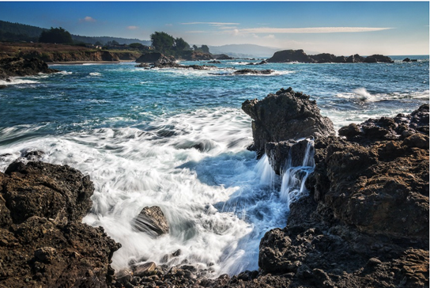
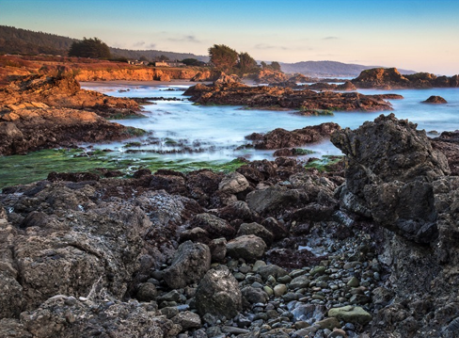
High Tide
Low Tide
Images courtesy of Dylan Kereluk, Wikimedia Commons
Bay of Fundy, Canada
Images by Alyssa Gundersen
http://www.thesearanchlife.com/tag/california-king-tide-project/
Shell Beach
Sonoma, California
Notes:
The difference between high and low tides in the Bay of Fundy in Canada can be as large as 16 meters (the height of a 3-story house). This is because the bay is funnel-shaped.
In the Mediterranean Sea the tidal range is only a few centimeters on average.
In California, where a lot of intertidal research has been done, the tidal range is about 7 ft (about 2.25 m).

Slide 6
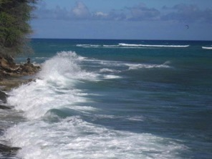
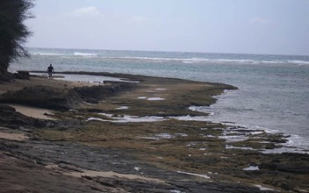
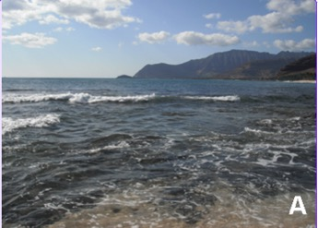
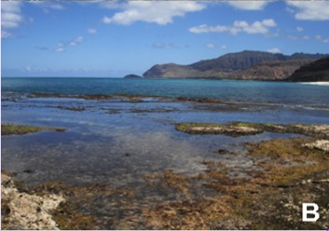
Tidal Range in Hawai‘i ~ 1 m (3 ft)
High Tide
Low Tide
Diamond Head
O‘ahu
Pictures by T. Erin Cox
Ma‘ili Point O‘ahu
Pictures by Alyssa Gundersen
Notes:
In Hawaii the entire intertidal is about a 1 m (3 ft) zone along the coast.
While a relatively small tidal range, you can see the differences between high and low tide from these pictures.

Slide 7
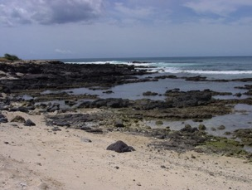
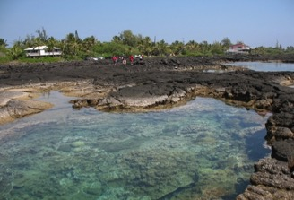
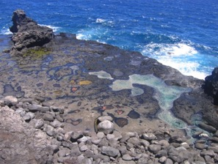
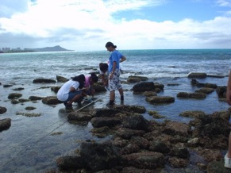
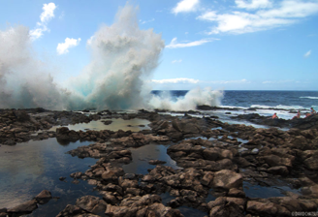
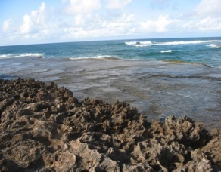
What factors determine which organisms live at an intertidal site?
Wai‘ōpae
Sandy Beach
Kalaupapa
Sand Island
Makapu‘u
Turtle Bay
http://www.alohafrom808.com/2011/06/makapuu-tidepools-and-waimanalo-may-30-2011/
Pictures by OPIHI
Notes:
Question: What do you think determines which organisms live at an intertidal site? Why?
Write student answers on board. The next slide has a list that can be used to fill in knowledge gaps.

Slide 8
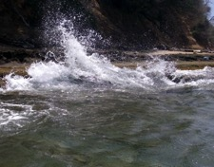
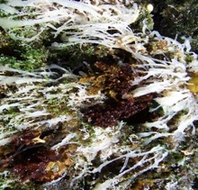
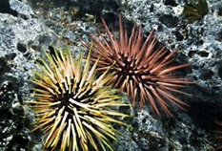
Factors that structure the intertidal
Abiotic Factors
Tide (height, frequency)
Waves & currents
Sunlight (quantity & quality)
Temperature (air and sea)
Shoreline shape & substrate (bottom) type
Freshwater (rainfall patterns & runoff)
Water chemistry (nutrients, salinity, turbidity)
Biotic Factors
Predation
Competition
Organism range (dispersal & colonization)
Pictures by T. Erin Cox
Notes:
Most of the plants and animals that live in the intertidal are marine in origin. Nearly all of them need water to breathe. So, the intertidal can be viewed as a naturally stressful environment.
Abiotic factors influence the intertidal.
The tide can vary in magnitude (small or large tidal heights). Tide frequency varies, some areas have one tidal cycle a day (diural), some have two (semi-diurnal).
Waves keep organisms wet and cool and bring nutrients to organisms. However, they can knock organisms loose.
Currents bring nutrients and affect how larvae move to an area.
Sunlight is important for photosynthesis, but too much can cause bleaching.
The temperature of both the air and sea is important. High temperatures (both water and air) can be stressful. Temperature changes rapidly with waves.
Temperature, sunlight, and wind can cause drying up (desiccation). Evaporation can cause changes in salinity.
The shape of the shoreline affects the tide and waves.
The substrate (bottom) type affect how porous and area is, the temperature (darker rocks retain heat), and rugosity (how uneven a surface is, uneven surfaces are shadier and provide refuges for organisms.
Freshwater (rain, streams, runoff) affects salinity and nutrients.
Water chemistry includes nutrients (nitrogen, phosphorus), salinity (salt), and turbidity (sediment in the water that can make it cloudy or clear).
Biotic factors also influence the intertidal through predation (by both land and sea predators) and competition for space and resources. The occurrence of an organisms in an area if determined by its ability to disperse to and colonize an area.
As move from low to high intertidal, more abiotic stress (most intertidal organisms are marine in origin and thus air exposure is stressful). As move from high to low intertidal, more competition for space, resources, and increasing predation.

Slide 9
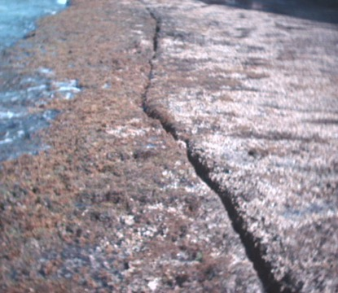
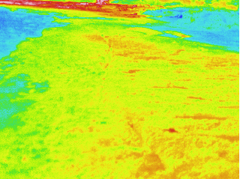
Before Wave
Example: Waves affect Temperature
°C
26
25
24
23
22
20
ocean
Total time elapsed: 0 s
landmark
Diamond Head Beach
Images by T. Erin Cox
Notes:
These slides show an example of how waves affect temperature.
The waves dramatically lowers substrate (bottom) temperature very quickly. This makes it hard to examine water quality factors in the intertidal.

Slide 10
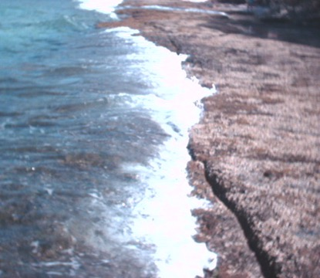
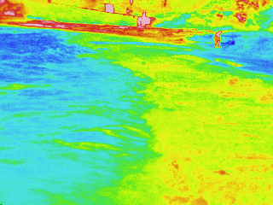
Wave
Example: Waves affect Temperature
°C
26
25
24
23
22
20
ocean
Total time elapsed: 42 s
landmark
Diamond Head Beach
Images by T. Erin Cox
Notes:
These slides show an example of how waves affect temperature.
The waves dramatically lowers substrate (bottom) temperature very quickly. This makes it hard to examine water quality factors in the intertidal.

Slide 11
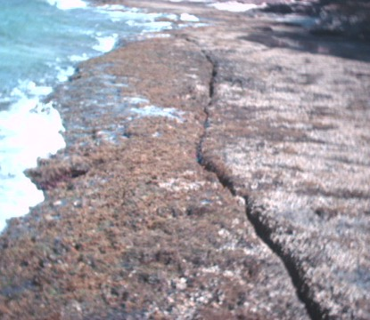
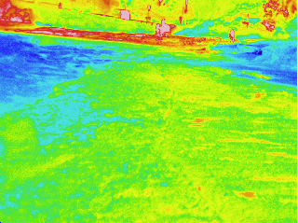
After Wave
Example: Waves affect Temperature
°C
26
25
24
23
22
20
ocean
Total time elapsed: 50 s
landmark
Diamond Head Beach
Images by T. Erin Cox
Notes:
These slides show an example of how waves affect temperature.
The waves dramatically lowers substrate (bottom) temperature very quickly. This makes it hard to examine water quality factors in the intertidal.

Slide 12
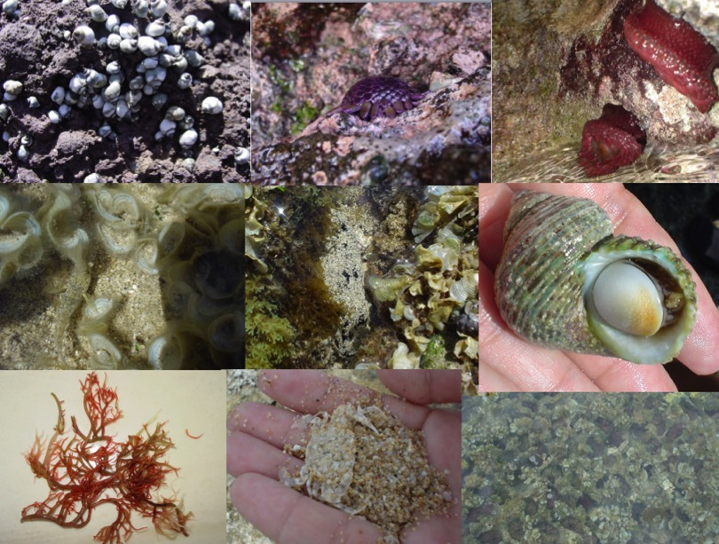
Unique Ecosystem = Unique Organisms
Pictures by OPIHI
Notes:
The organisms that live in the intertidal are uniquely adapted for the challenging set of living conditions that come from being alternatively submerged with water and exposed to air. They have adaptations that limit abiotic stress and alter biological interactions.
Question: What adaptations do you see in these pictures?
Many adaptations are to prevent water loss.
For example, operculum can seal a snail in its shell. The anemone is also pulling it’s arms into it’s body, this cuts down on the amount of surface area exposed to the sunlight and thus helps the anemone retain water.
Other adaptations are to prevent waves from knocking them loose.
Helmet urchins have plates as opposed to spines, and can clamp down and suction to the rocks to prevent breaking spines and water loss. Other urchins live in burrows to protect them from the elements.
Algae can’t hide in crevices (no sun!), some are very flexible (like this species of graciliaria) and bend with the waves. If the algae was brittle, they would break under all the pounding.
Other algae, like. the pink crustose coralline algae with the helmet urchin, are like paint.
And some adaptations are for camouflage.
Can you see the crab, fish, and sea cucumber in these pictures?

Slide 13
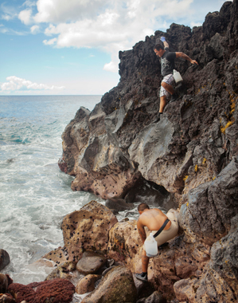
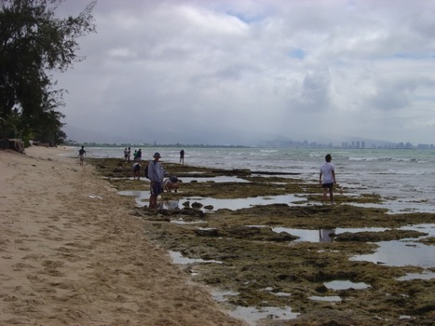
Tidal Range in Hawai‘i ~ 1 m (3 ft)
Intertidal
Intertidal
Picture by OPIHI
Low Tide at ‘Ewa Beach, O‘ahu
http://www.honolulumagazine.com/Honolulu-Magazine/November-2011/The-Opihi-Shellfish-Story/?cparticle=2 Photo: Josh Fletcher
Notes:
In areas with a large tidal range, like in California, there may be clear biological zones differentiating high, mid, and low tide zones.
In Hawaii, especially on flat benches like this one in Ewa, these zones are blurred due to small tidal range.
However, different intertidal zones are more readily visible on steep rock faces as colored bands in these zones are often characterized by different species.
Within each zone there are creatures that have adapted to thrive in the unique combination of air and water exposure.

Slide 14
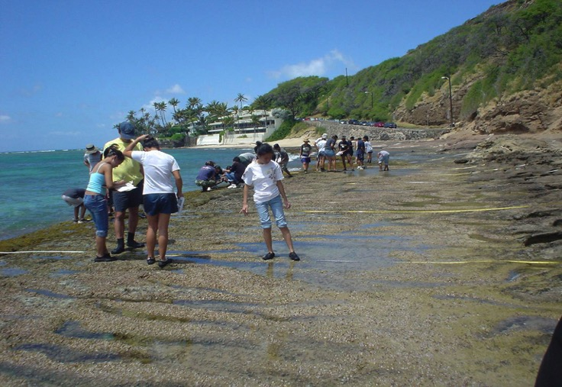
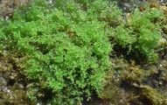
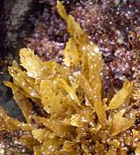
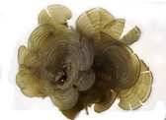
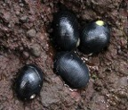
Some intertidal areas have zonation
Diamond Head, O‘ahu
Laurencia mcdermidiae
Padina sp.
Sargassum sp.
Siphonaria normalis
Nerita picea
Off shore
On shore
Images by T. Erin Cox
Notes:
Some flatter bench areas do show evidence of zonation.
This is an example of the species that occur from low to high intertidal along Diamond Head Beach on Oahu.

Slide 15
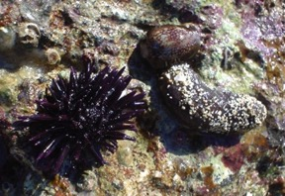
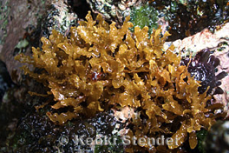
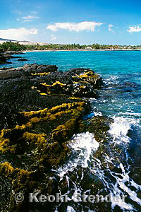
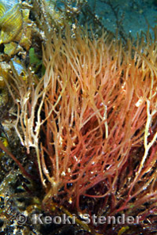
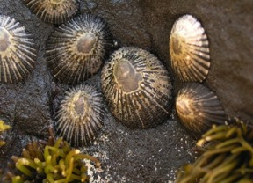
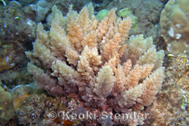
Importance of Intertidal
Limu ‘aki ‘aki
Ahnfeltiopis concinna
Hawaiian
Cultural,
Medicinal,
Culinary, &
Religious
Practices
Limu kala
Sargassum aquifolium
Limu manauea
Graciliaria cornopifolia
Limu kohu
Asparagopsis taxiformis
Black-foot ‘opihi
Cellena exarata
Nursery
marinelifephotography.com
Manini
Acanthurus triostegus
Notes:
The intertidal is an important part of Hawaiian cultural practices. Hawaiians harvest limu (native algae) for food as well as for medicine and religious ceremonial purposes. For example:
Limu kohu – Asparagopsis taxiformis (rinsed, soaked, salted, pounded, rolled into balls and added to poke, lomi, or stewed beef)
Limu manauea – Graciliaria cornopifolia (ogo) – light salting – poke
Limu kala – Sargassum aquifolium – food as well as powerful symbol of forgiveness in the ho’oponopono gathering, ceremony in which troubles are set right
Limu ‘aki ‘aki – Ahnfeltiopis concinna – eaten in imus
Cowries (leho) used for jewelry, eaten, as scrapers and octopus lures. Urchins (Echinometra oblonga, ‘ina ‘ele’ele) and sea cucumbers also eaten.
The intertidal is also important ecologically. It serves as a nursery for species that live their adult lives in the subtidal.
Many of the species in the intertidal are native and endemic (limu kala, limu manauea, limu ‘aki ‘aki, opihi)

Slide 16
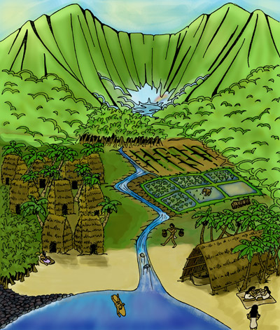
Intertidal at Base of Watershed
Intertidal is at base of watershed; affected by everything upstream
Watershed: Area of land that collects rainwater into a common outlet (e.g., river, ocean)
Ahupua‘a (Hawaiian watershed): Generally land from the mountains to the coast & coastal ocean (e.g., nearby coral reef)
http://ethnomusicologyreview.ucla.edu/journal/volume/18/piece/698
Illustration by Mele McPherson. Image courtesy of Hale Kuamo‘o, The Hawaiian Language Center, University of Hawai‘i at Hilo.
Notes:
The intertidal is important because it is at the base of the watershed and is affected by everything that happens upstream (pollution, runoff of nutrients and sediment, urbanization, etc.).
Watersheds are an area of land that collects rainwater into a common outlet like a stream or river, the water eventually flows to the ocean.
An ahupua‘a is the Hawaiian equivalent of a watershed. It includes the land from the mountains to the coast and offshore resources (like coral reefs).
The size of an ahupua‘a can vary from as little as 100 acres to more than 100,000 acres.
Traditionally, people living within ahupua’a boundaries had resource management practices determining when it was okay to gather resources, like food, and when resources needed to rest. The upland forests were recognized as important for supplying water. The plains were used for growing food. The coastal areas were also for used for growing food, including fish in coastal ponds.
Question: What watershed are you in?

Slide 17
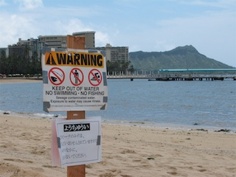
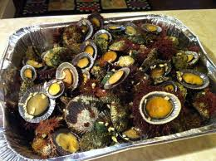
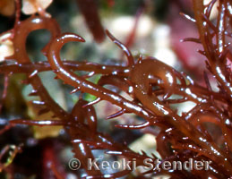
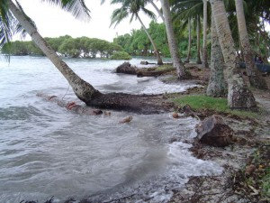
Human Threats to Intertidal
Development
Overharvesting
Wikipedia Commons KeithH
https://kamfamily.wordpress.com/2011/06/14/12-mouthwatering-tastes-of-maui/
Species Introduction (may become invasive)
Climate Change
marinelifephotography.com
http://mauitime.com/news/politics/state-of-hawaii-signs-onto-majuro-declaration-on-climate-change/
Notes:
Development causes habitat destruction, runoff of sediment and nutrients, eutrophication, and trampling.
In addition to the nutrient inputs by fertilizer runoff, Hawai‘i has long had a problem with sewage in coastal waters, including sewage spills, injection wells, and leakage from cesspools. Submarine ground water discharge can deliver nutrient-polluted groundwater to coastal regions in Hawai‘i.
Because the intertidal is so accessible – it is often affected by over-harvesting or over-collecting.
For example, black-foot opihi are essentially extinct on Oahu due to overharvesting and severely depleted on other main hawaiian islands (Bird, 2015). Conservation efforts are constrained by opihi’s limited larval dispersal.
The intertidal is often the first area of appearance of alien species. Alien species are species introduced to Hawaii (e.g., on boat hulls), (as opposed to native species which evolved in Hawaii). Although some introduced species seem to have little impact, other can be very harmful and are called invasives, as they invade and change the native ecosystem. Hypnea musciformis (hookweed) was imported to Hawaii illegally from Florida for aquaculture, but didn’t work well. It cost Maui County $20 million in 2000 from lost revenue.
The degree to which intertidal species might respond climate change, including sea level rise and increasing air and sea temperatures, is not clear. On one hand, the intertidal zone is very resilient. However, some researchers in California have found that intertidal species ranges shifted northward over 60 years (e.g., Barry et al., 1995; Sagain et al., 1999). On islands, intertidal species are not able to shift their geographic ranges northward. They can adapt or go extinct.

Slide 18
Intertidal is hard to study
Limited low tides during daylight hours
Month
Jan
Feb
March
April
May
June
July
Aug
Sept
Oct
Nov
Dec
0
5
10
15
20
25
Feet
Number of Days
Honolulu, HI 2007 NOAA
Image by T. Erin Cox
Notes:
The intertidal in Hawai‘i is difficult to study due to seasonal wave activity, a small low tide window, and limited tidal range.
This graph shows the number of days each month with negative low tides. The intertidal is only exposed for a few hours each day before the tide comes back up. Most “good” tidepooling days are in the spring and summer.

Slide 19
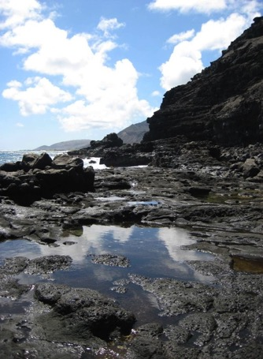
Summary: Hawai‘i’s Intertidal
Culturally, economically, & ecologically important
At base of watershed
  Impacted by both land & sea issues
Has not been well-studied in Hawai‘i
  Small tidal range
  Small organisms (compared to more northern areas and nearby coral reef)
  But… easy to get to for students!
Image by T. Erin Cox
Notes:
The intertidal is a model habitat in which to measure ecological change. However, the intertidal zone of tropical islands has been poorly studied, particularly in comparison to other regions.
However, the accessibility that makes the intertidal especially susceptible to human impacts also makes it ideal for student researchers to study.

Slide 20
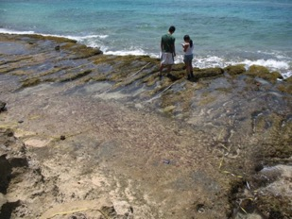
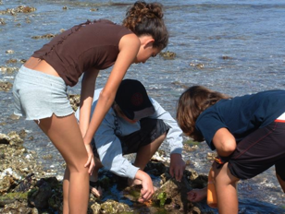
OPIHI Goals
  OPIHI is a real scientific research project to describe Hawai‘i’s rocky intertidal
  Scientists need student help to collect information about this area
  Scientific Goals:
    Re-survey sites from 10 years ago
    Expand to new areas
Pictures by OPIHI
Notes:
This is a real research project. Data collected will help scientists understand Hawaii’s rocky intertidal.
Surveying in this type of environment, because is is hard to look at due to the small tidal windows, requires large numbers of trained researchers to work together.
The scientific goals of this project are to re-survey sites that OPIHI looked at 10 years ago and to expand to new intertidal areas.

Slide 21
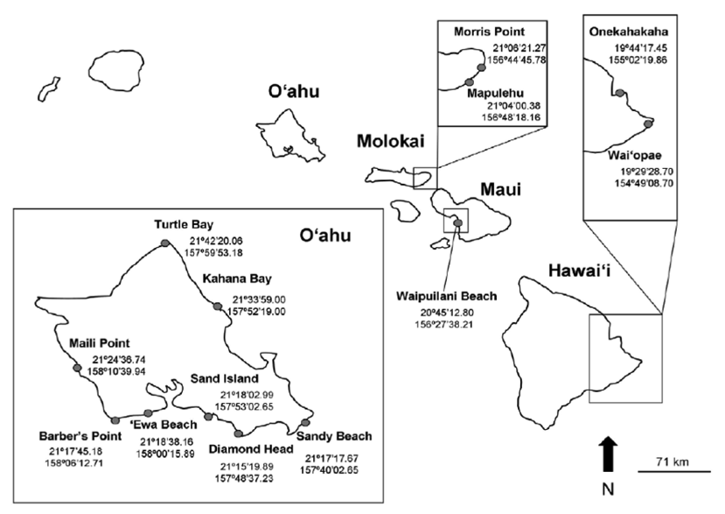
2004–2007 OPIHI Locations
Sand Island
(Cox. et al., 2013)
Notes:
These were the sites surveys by OPIHI from 2004 to 2007. We will be re-surveying these sites and adding new sites.

Slide 22
Our Site
Notes:
Include pictures of your intertidal site here!

Slide 23
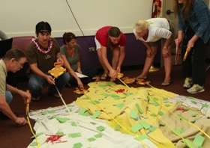



In Class
  Learn methods for studying
  the abundance of organisms
  water quality
  Practice identifying intertidal organisms
Images by A. Faucci, K. Longenecker, J. Philippoff, K. Seraphin
Notes:
In class we will learn what sampling is, learn and practice methods for studying the abundance of organisms, and learn how to study some water quality parameters.
We will also learn how to identify intertidal organisms, and practice using identification cards and books.

Slide 24




In the Field
  Follow OPIHI protocol to collect data that can be shared with other students and scientists
Images by T. Erin Cox, K. Seraphin, R. Langston & OPIHI
Notes:
In the field, we will use ecological tools to collect data that can be shared with other scientists and student researchers.

Slide 25




Why is water quality important?
Waipuilani Beach, Maui
Pelekane Bay, Hawai‘i
Images from presentations by T. Weigner & H. Spalding
Notes:
Question: Why do you think water quality is important?
Examples:
Water quality affects human’s ability to swim and harvest food (e.g., fish) safely.
Invasive algae stimulate Fibropapillomatosis (tumors) in Hawaiian green turtles by sequestering high levels of the amino acid arginine in eutrophied waters (Van Houtan et al., 2014).
Invasive algae, simulated by high nitrogen levels from injection wells on Maui, blooms and creates problems (e.g., rots on beaches and makes area less desirables for tourists and locals).
Sediment runoff makes water turbid (less clear).

Slide 26


Water quality is important
Human health
Ecosystem health
Economies
Culture
OPIHI Focuses on:
Temperature
Salinity
Dissolved Oxygen
Turbidity
The red algae Kappaphycus and Eucheuma
overgrowing coral in Kane‘ohe Bay
Images from presentation H. Spalding
Notes:
Water quality is important for human health, ecosystem health, economies, and culture.
For example, Kappaphycus/Eucheuma was legally introduced by scientists and industrialists in an effort to develop new techniques and industries for Hawaii. It did not work, and was released into the wild. The algae now overgrows pukas and coral, smothering reef in Kaneohe Bay.
OPIHI will be focusing on four water quality parameters: Temperature, salinity, dissolved oxygen, and turbidity. Your teacher may add additional parameters.

Slide 27


Temperature:
Measure of the average kinetic energy of molecules
What factors might affect temperature in the intertidal?
Image from K. Seraphin
Notes:
The temperature in large bodies of water is generally controlled by climate and currents. In small pools or shallow lakes, temperature is affected by shading from rocks or plants, water flow rate, and water depth. Additionally, industrial discharge or sewage outflow can decrease or increase water temperature, an effect called thermal pollution.
Temperature influences a wide variety of biological processes, like metabolism. Some organisms are able to withstand a wide range of temperatures. Other organisms can be adversely affected by even a small change in temperature.
Temperature in the intertidal depends on a number of factors including wave action, tidal height, air and water temperature, and rainfall. The ground also affects temperature. Intertidal areas with darker substrate will have a higher temperature than lighter substrate. Rugosity, or how uneven the substrate is, and slope can affect temperature by providing shade. Tidepools temperature is affected by the rugosity, volume, and depth of the pools.
It is important to measure both the temperature of the air and water.

Slide 28

Salinity:
Measure of the amount of dissolved salt in water
What factors might affect salinity in the intertidal?
Image from K. Seraphin
Notes:
Salinity can be affected by evaporation and freshwater input from rain, rivers, and glacial melting. Most marine and freshwater organisms have a narrow range of salt tolerance. However, some organisms that live in environments like the intertidal have a wide range of salt tolerance.
Salinity in the intertidal is affected by rain and other freshwater sources, like nearby streams. All of the things that affect evaporation rates affect salinity, like temperature, wind, wave action, and location in the intertidal (high vs. low). In intertidal areas with tidepools that are cut off from the ocean during low tide, these pools can experience high evaporation rates and become very salty.

Slide 29

Dissolved Oxygen:
Oxygen gas dissolved in water
What factors might affect dissolved oxygen in the intertidal?
Image from K. Seraphin
Notes:
Dissolved oxygen is a free oxygen molecule (O₂), rather than the oxygen atom bound to hydrogen in a water molecule (H₂O). Oxygen gas enters the water from the atmosphere and from photosynthesis by algae and aquatic plants. Oxygen gas leaves the water through respiration by algae, plants, animals, bacteria, and other microorganisms. Other chemical reactions, like decomposition of organic wastes, also remove oxygen.
The amount of oxygen that water can hold is determined by pressure, salinity, and temperature. Gas solubility increases with pressure. Water at low elevations (more pressure) holds more O₂ than at high elevations (less pressure). Gas solubility increases as salinity decreases. This means freshwater holds more O₂ than saltwater. Seawater holds about 20 percent less dissolved oxygen than fresh water at the same temperature. Gas solubility increases as temperature decreases. This means cold water holds more O₂ than warm water.
Dissolved oxygen is lower in the early morning because no organisms can photosynthesize at night, but they all need to respire.
The amount of dissolved oxygen needed to sustain life depends on the water body (e.g., stream vs. ocean) and the type of life. For example, fish have higher metabolic rates than crabs, fish need more oxygen to survive than crabs. Crabs have higher metabolic rates than mussels.

Slide 30



Turbidity:
A measure of the clarity of cloudiness of the water
What factors might affect turbidity in the intertidal?
Image from K. Seraphin
Notes:
Turbidity can be caused by biogenic particles in the water, such as plankton, microscopic organisms, and organic debris. Turbidity can also be caused by abiogenic particles in the water, such as sand, mud, or silt. Algal blooms and organisms stirring up sand and sediment can increase turbidity. Waves, runoff, or flooding can increase turbidity. Wastewater carries many types of suspended solids and can also increase turbidity.
Some areas have natural high turbidity (like nutrient-rich waters in the northern latitudes). Some areas often have lower turbidity (like nutrient-poor coral reef waters). A change in turbidity may indicate a disturbance in an ecosystem. For example, an increase particles associated with high turbidity can block light from reaching plants, slowing down photosynthesis, which can affect dissolved oxygen levels. If the water is very cloudy, aquatic organisms may be less able to see and catch food. Particles can clog fish gills and smother other organisms. Suspended particles also provide a surface for bacteria and pollutants to attach.

Slide 31
Measuring Water Quality
at your Intertidal Site
Where you do think levels will be high and low for each of these measurements?
How will you collect data?
Make sure you know how to use the tools you will be using in the field.

