Slide 1
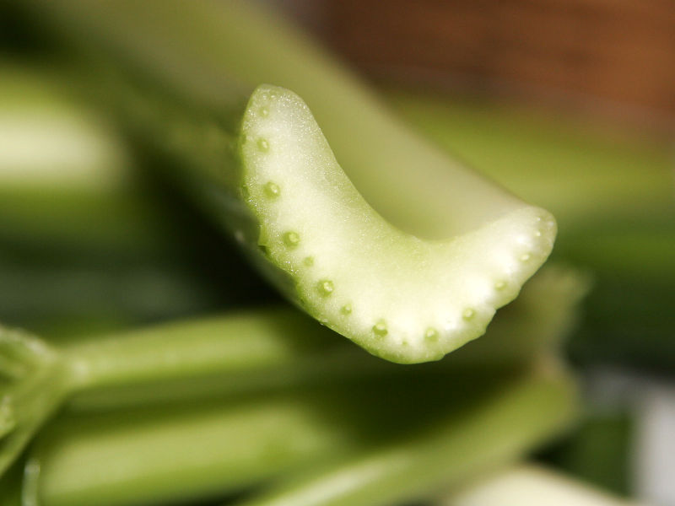
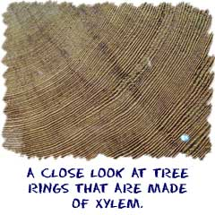
Marine algae
Unlike terrestrial (land) plants, marine algae have NO vascular material (like xylem and phloem)
Notes:
Dots in the celery are vascular bundles containing xylem and phloem. Tree rings are made from xylem

Slide 2
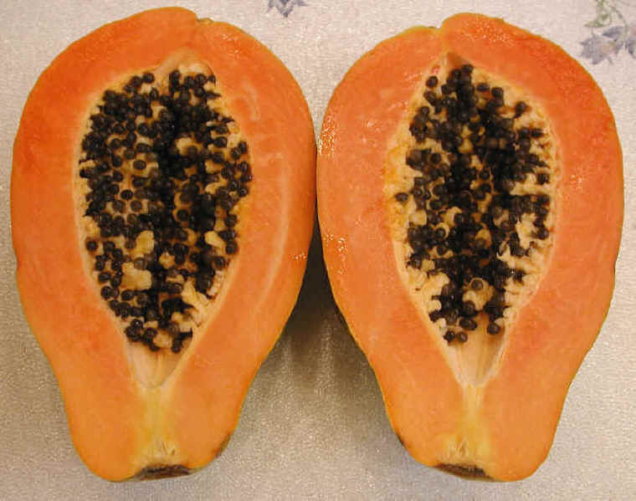
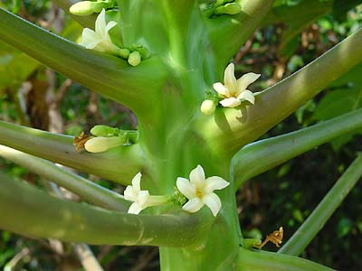
Unlike terrestrial plants, marine algae have NO flowers, seeds, or pollinators
Marine algae

Slide 3
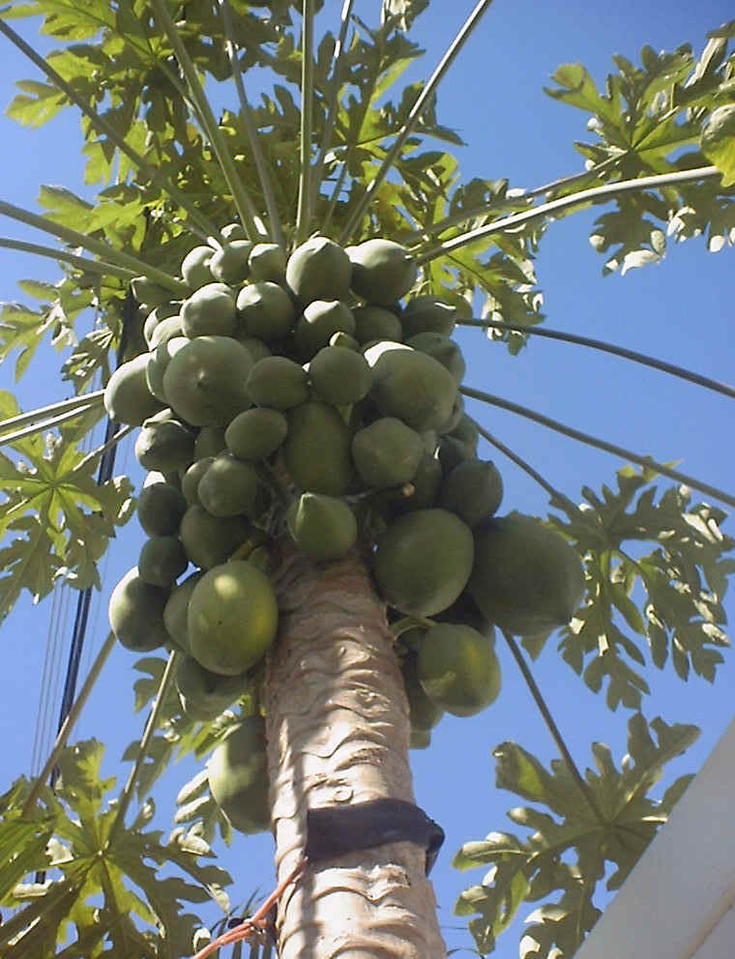
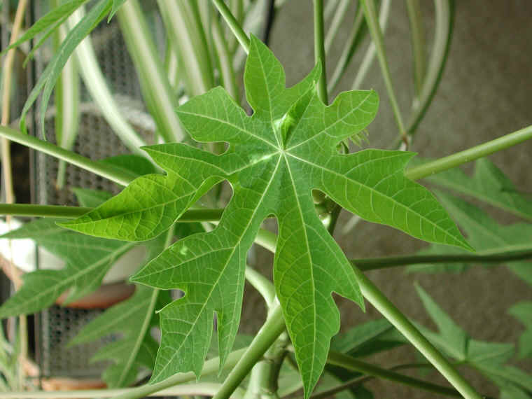
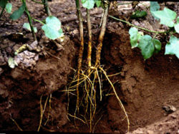
Unlike terrestrial plants, marine algae have NO high level of specialized organ differentiation
Marine algae

Slide 4
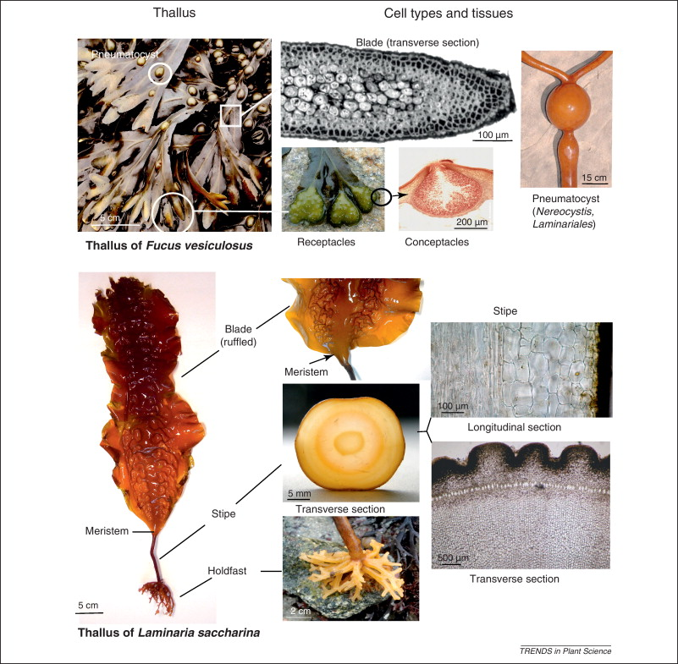
Marine algae have developed other structures specialized for living in seawater.

Slide 5
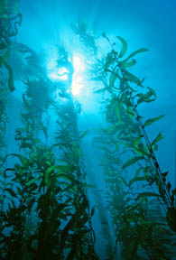
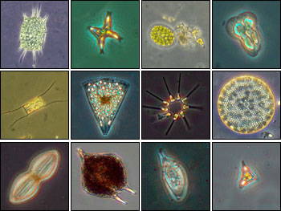
Algae range in size from tiny microscopic life to giant ocean kelps over a hundred feet long!

Slide 6
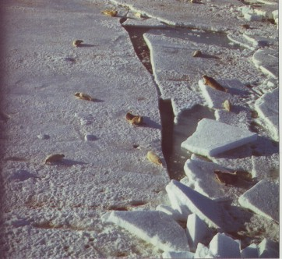
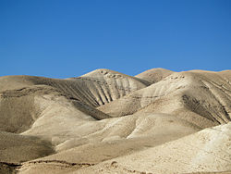
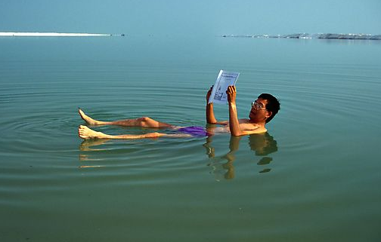
Algae live in the driest deserts, the coldest tundras, and all types of waters.

Slide 7
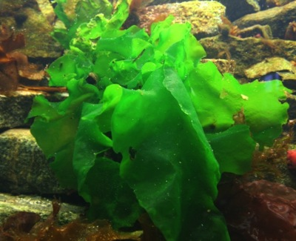
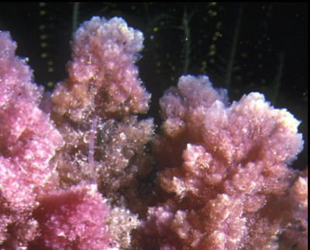
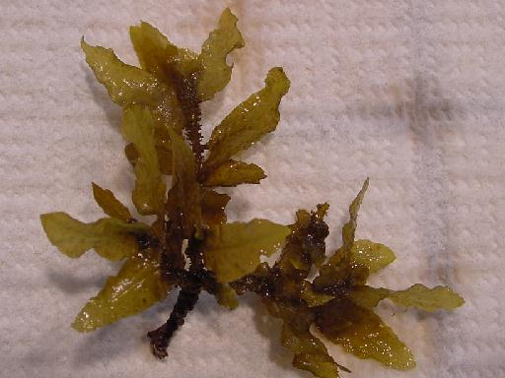
Three main “divisions” of marine algae:
Chlorophyta – green algae
Rhodophyta – red algae
Phaeophyceae – brown algae
Notes:
ID tricks
Groups based on pigments
Algae are classified into groups based on pigment composition/types.

Slide 8
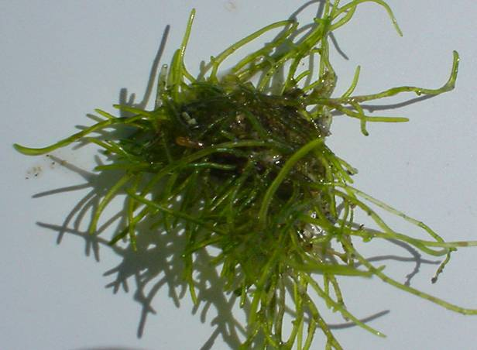
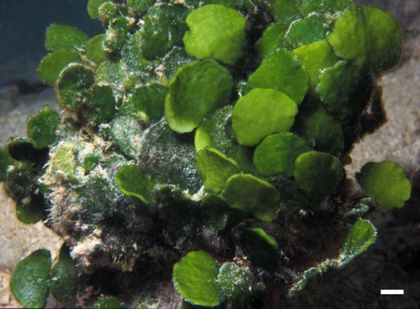
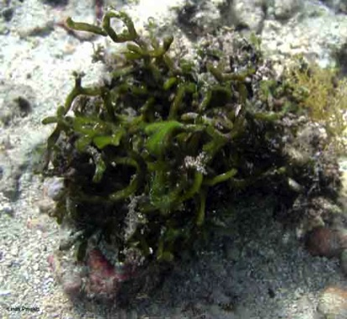
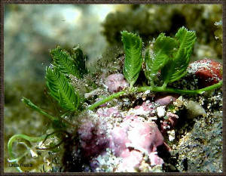
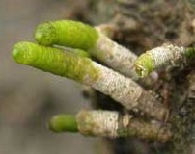
Common Chlorophyta in Hawai‘i
Cladophora/Cladophorpsis
Ulva (Limu pālahalaha)
Halimeda discoidea
Codium
(Limu wāwae‘iole)
Caulerpa
Neomeris

Slide 9
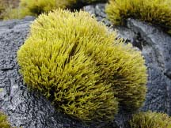
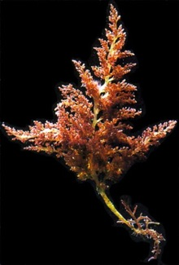
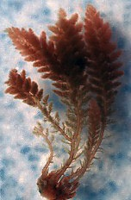
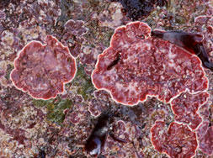
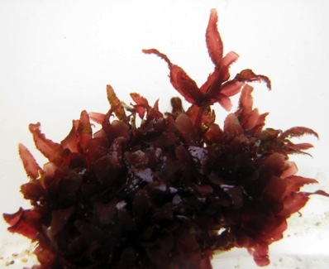
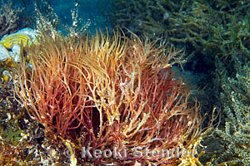
Common Rhodophyta in Hawai‘i
Ahnfeltiopsis
(Limu ‘aki ‘aki)
Laurencia
(Limu mane‘one‘o)
Asparagopsis
(Limu kohu)
Crustose Coralline Algae
Gracilaria coronopifolia
(Limu manauea)
Amansia

Slide 10
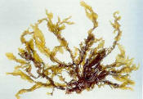
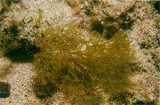
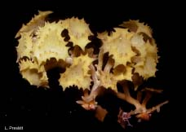
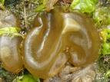
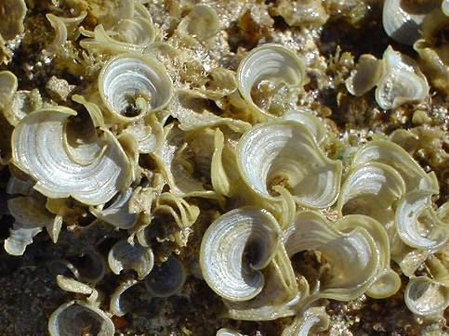
Common Phaeophyceae in Hawai‘i
Dictyopteris (Limu lipoa)
Dictyota
Turbinaria
Sargassum (Limu kala)
Colpomenia
Padina

Slide 11
Defining algae & plants
Brown Algae
Phylogenetic Tree
Branching patterns show evolutionary relationships
Phylogenetic definition: Land plants and green algae closely related, but brown algae has a different evolutionary history.
Notes:
3 Domains - Eukaryote - cells contain complex structures enclosed within membranes - particularly the nuclear envelope
Phylogenetic tree. Branches show how organisms are related, it shows common ancestry - this tree is based on the analysis of DNA in these organisms.
The further back (to the left) something branched = more ancestral/basal, the further forward = more derived.
http://5e.plantphys.net/article.php?ch=t&id=399

Slide 12
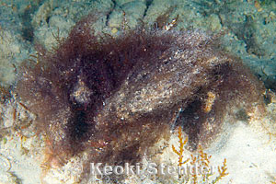
Cyanophyta
(Blue Green Algae)
But… not alge. Bacteria.

Slide 13
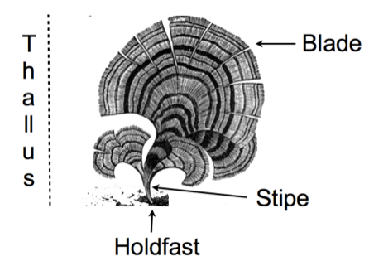
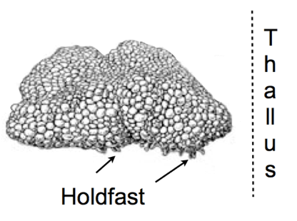
Algal Morphology
Notes:
EMPHASIZE Form/function - adapted to environment
A couple morphological features of algae. These are just guidelines... not all algae have all these features. They just help us talk about the algae. New vocabulary
Thallus is the body of the algae,
Holdfast helps the alga attach to the substrate - NOT like roots - roots have storage or vascular tissue
Stipe is stemlike feature (but not a stem) - similar to leaves (but no vascular tissue)
Blade is a leaflike structure - similar to stem (but no vascular tissue)

Slide 14
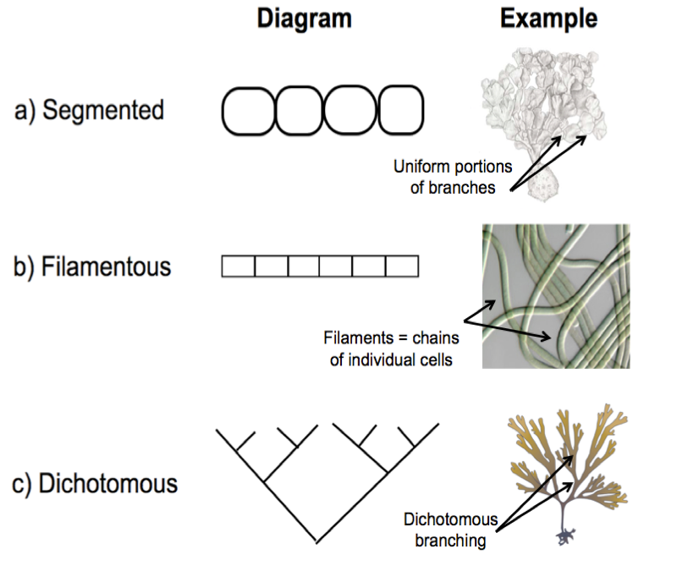
Algal Morphology
Notes:
EMPHASIZE Form/function - adapted to environment
different body plans
Filamentous = single cell chains

Slide 15
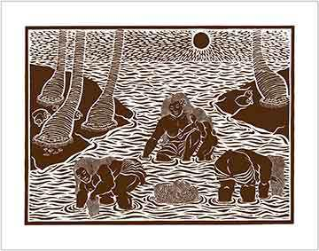
Algae, or limu, are culturally important in Hawai‘i

Slide 16
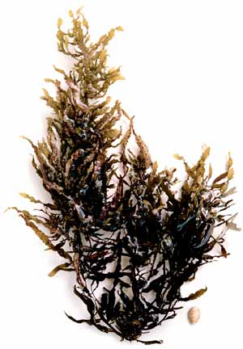
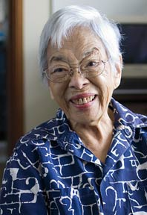
Limu kala is important culturally, such as in ho‘oponopono.
https://de-de.facebook.com/video/video.php?v=10200351051608526
Sargassum, or Limu kala
Notes:
https://de-de.facebook.com/video/video.php?v=10200351051608526

Slide 17
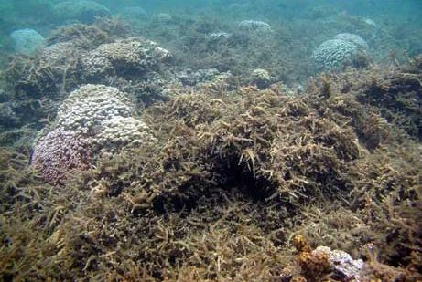
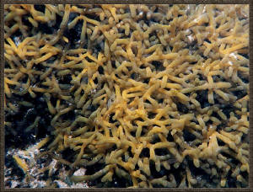
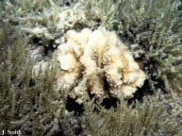
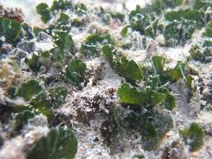
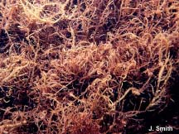
Marine algae can be invasive and have a negative effect on the marine environment

Slide 18
Introduced, Invasive Algae: The red algae Kappaphycus and Eucheuma overgrowing coral in Kane‘ohe Bay
Notes:
Legally introduced by scientists and industrialists in an effort to develop new techniques and industries for Hawaii
Didn’t work, released into wild
Coral mimic, overgrows pukas and coral, no native grazers here

Slide 19
Introduced, Invasive Alga: The red alga Gracilaria salicornia (Gorilla ogo)
Notes:
Introduced by scientists and industrialists

Slide 20
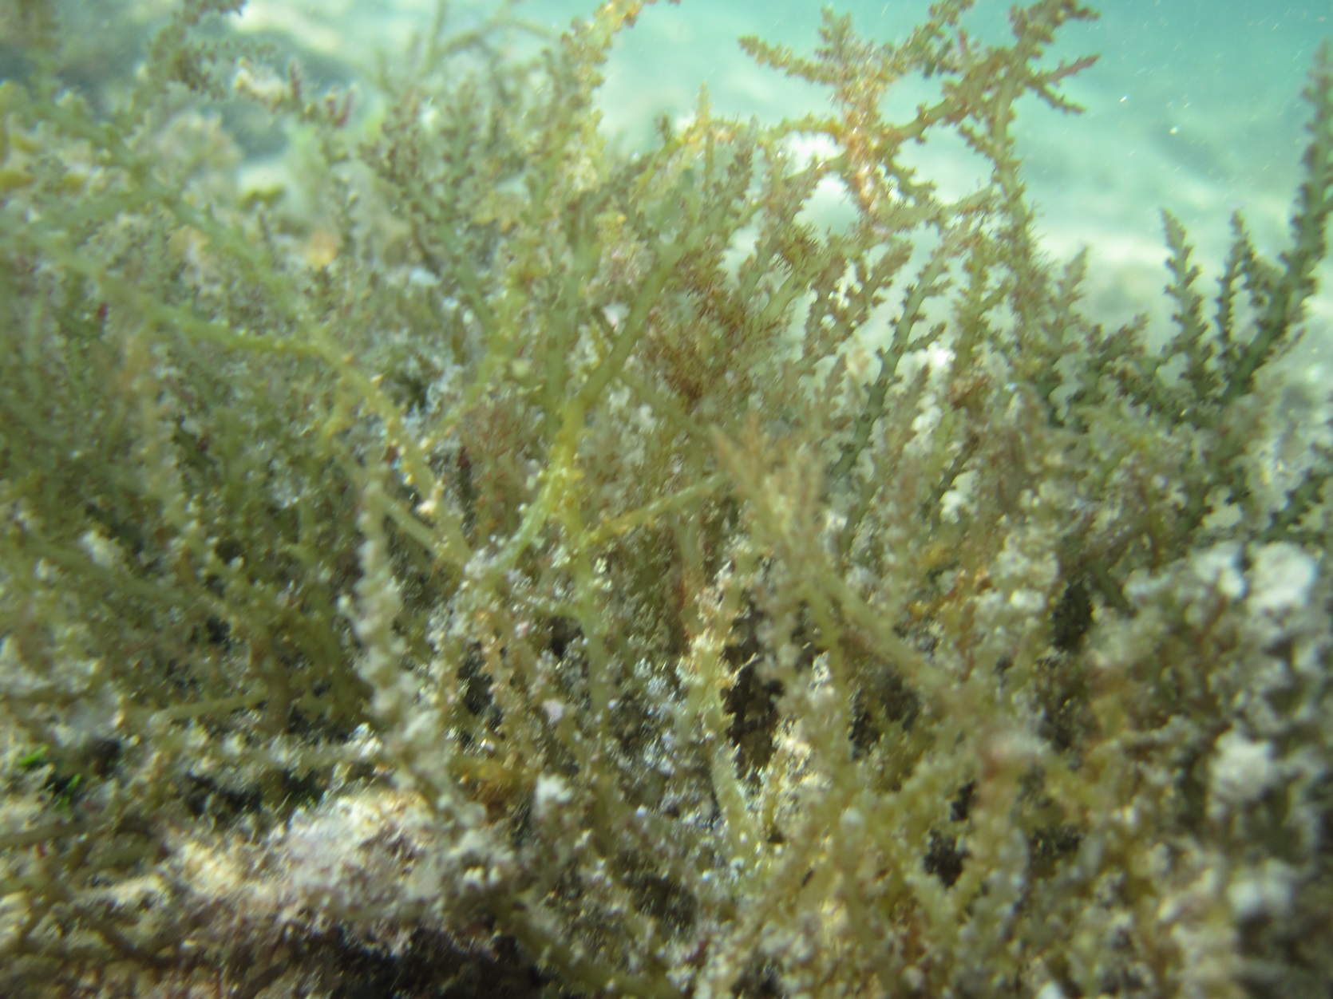
Introduced, Invasive Alga: The red alga Acanthophora spicifera (Spiny weed)
Notes:
Introduced to Pearl Harbor as a hull fouler from Guam
Preferred food item by grazers

Slide 21
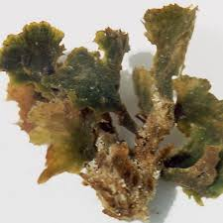
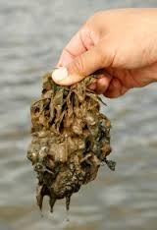
Invasive Alga: The green alga Avrainvillea sp. (Leather mudweed)
Brostoff 1981, Peyton 2009
Notes:
Avrainvillea – source unknown, but forms expansive beds in deep water
First reported in 1981
Outcompeting native seagrasses in shallow water in Maunalua Bay

Slide 22
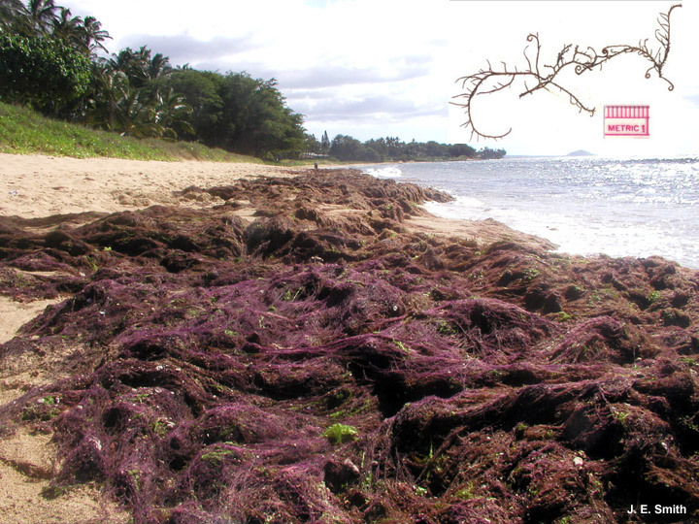
Invasive Alga: The red alga Hypnea musciformis (Hookweed)
Notes:
Imported to Hawaii illegally from Florida for aquaculture, but didn’t work well for aquaculture
Cost Maui County $20 million in 2000 from lost revenue

Slide 23
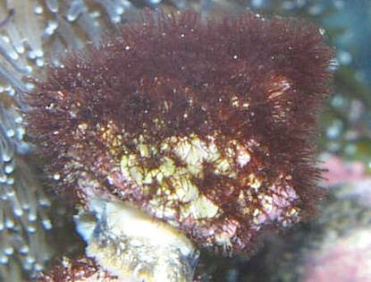
OPIHI Identification Cards
(Mostly) organized by color
Lots of things not on ID cards! Consult books and over resources.
Focus on identifying things to genus
Things that are hard to ID in field are grouped together (e.g., crustose coralline algae, turf algae)
If you cannot ID something, richly describe and photograph it; bring it to the classroom to ID later if you can.
Crustose Coralline
Algae (CCA)
Turf Algae
“Fuzzy rock”

Slide 24
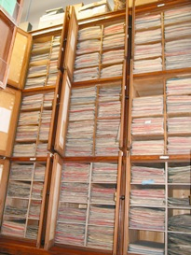
Preserving Algae
Notes:
Algae pressing is common to preserve algae.
Herbarium is a collection of botanical specimens. Bishop museum is actually the largest herbarium in the Pacific... this is where people can come for all over the world to see type specimens and get information about algae.

Slide 25
Building an Algae Press
Cardboard
Blotter
Wax paper
Alga
Heavy paper
Blotter
Cardboard
Notes:
Pat alga dry with a towel.
Position the alga on your heavy paper so that it is centered. Spread out the thallus, branches, and blades. Be sure to position the alga so that any unique characteristics are visible. If the alga is a large thick clump, you may need to cut the alga in half so it will lay flat or choose a smaller piece.
Write YOUR NAME and the genera or species name in pencil on the heavy paper so that the algae can be identified after pressing.
Build your algae press. Repeat steps as many times as needed.
A blotter = newspaper, towel, or fabric. Blotters will help remove moisture from the alga in your press.
Add weights on top - wait up to a week

