Slide 1
This is the Story of a Moth
Living in Old England

Slide 2
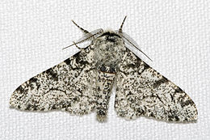
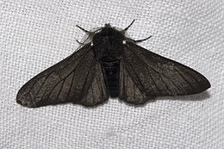
The Peppered Moth

Slide 3
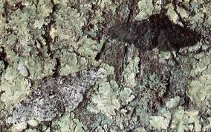
In normal, clean England

Slide 4
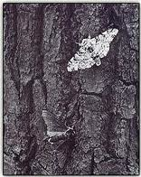
In polluted England

Slide 5
You predict:
When England solved it’s air pollution, the peppered moth population changed again.
How did it change?
Why?

