Slide 1
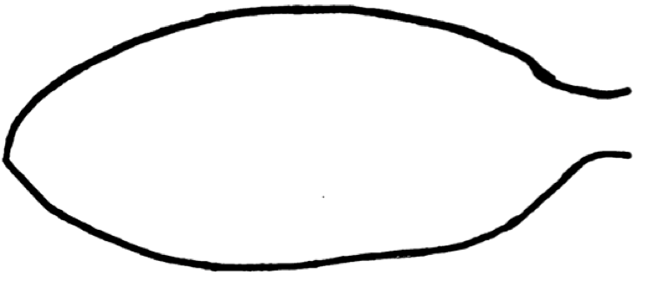
Name: Date: Pd:
Sedimentary Rocks: Draw a Fish
Sedimentary rocks are often rich in FOSSILS because the remains of dead organisms – bone, shell, stems, etc. fall to the bottoms of rivers, lakes and oceans where they are gradually covered over by sediment.
Driving Questions: What does the external anatomy of a fish look like?
Which parts might you see preserved as a fossil in a sedimentary rock?
Homework Procedure:
1. Choose a type of fish. Think of its shape in your mind. Use a pencil to draw on the fish form to complete the outside of the fish. (You may also draw your fish freeform on the back to have more control over the body shape.)
2. Include all of the external anatomy that you can remember for your type of fish.
3. Label the fish parts you drew with any names you know.
Classwork: Observe your classmates’ fish drawings.
*What are 3 similarities and 3 differences between your fish drawing and your classmates’?

Slide 2
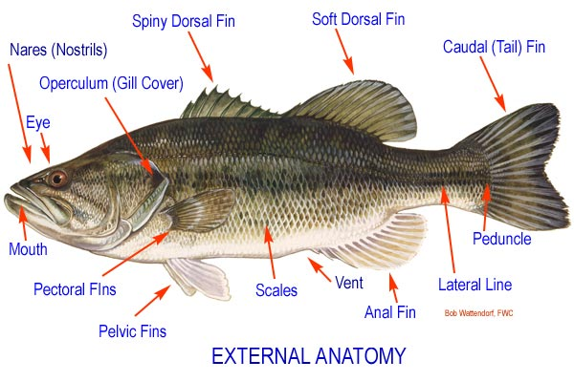
Fish Rubbing Procedure
Place paper over the rubber fish, hold firmly so the paper won’t slide!
Lightly rub ALL surfaces with the side of a crayon to create a copy of the fish.
Label the parts in pen.
6.
7.
5.
4.
3.
1.
8.
2.
14.
12.
11.
9.
10.
13.

Slide 3
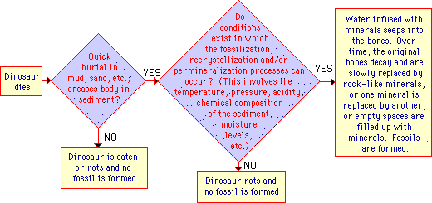

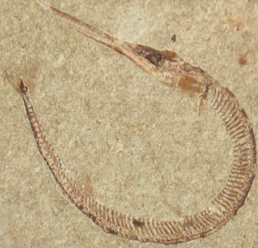
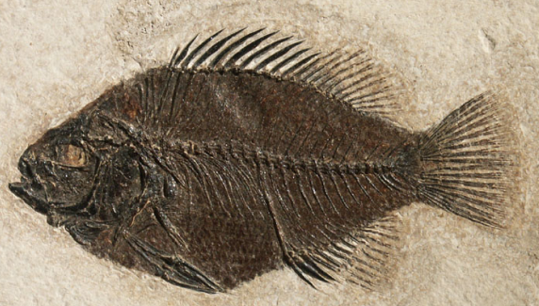
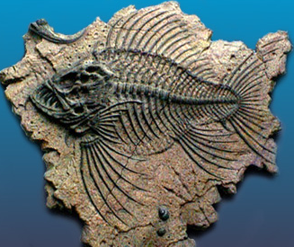
HOW FOSSILS FORM
Fossils of fish (and other species) were formed as follows:
The organism dies
It is quickly buried after death (by sinking in muddy sediments, being buried in a sand storm, etc.).
Over time, more and more sediment covers the remains.
The parts of the animals that escape rot (usually the harder parts likes scales, stems, bones and teeth) are encased in the newly-formed sediment.
In the right circumstances (no scavengers, quick burial, not much weathering), remaining parts of the animal turn into fossils over time.
After a long time, as the bone slowly decays, water carrying dissolved minerals seeps into the bone and replaces the chemicals in the bone with rock-like minerals. The process of fossilization involves either:
  the dissolving and replacement of the original minerals in the object with other minerals
  permineralization, the filling up of spaces in fossils with minerals,
  Recrystallization where mineral crystals change form.
This process results in a heavy, rock-like copy of the original object - a fossil. The fossil has the same shape as the original object, but is chemically more like a rock! Some of the original hydroxy-apatite (a major bone constituent) remains, although it is saturated with silica (rock).
WHY ARE FOSSILS RARE?
6 WAYS ORGANISMS TURN INTO FOSSILS:
Unaltered Preservation - like insects or plant parts trapped in amber, a hardened form of tree sap
Permineralization/petrification - in which rock-like minerals dissolved in water seep slowly into the cells and fill and replace the original organic tissues with silica, calcite or pyrite, forming a rock-like fossil - can preserve hard and soft parts - most bone and wood fossils are permineralized
Replacement - An organism's hard parts dissolve and are replaced by other minerals, like calcite, silica, pyrite, or iron)
Carbonization - in which only the carbon remains in the specimen, other elements, like hydrogen, oxygen, and nitrogen are removed
Recrystallization - hard parts either revert to more stable minerals or small crystals turn into larger crystals
Authigenic preservation - molds and casts of organisms that have been destroyed or dissolved
4 TYPES OF FOSSILS:
MOLD FOSSILS (a fossilized impression
made in the substrate - a negative image
of the organism)
CAST FOSSILS (formed when a mold is filled in)
TRACE FOSSILS = ichnofossils (fossilized nests, gastroliths, burrows, footprints, etc.)
TRUE FORM FOSSILS (fossils of the actual animal or animal part).

