Slide 1
FE 2-3
Measuring Salinity
2012

Slide 2
MEASURING SALINITY
Density and Salinity
  Seawater has a greater density than fresh water
  Dissolved mineral matter gives seawater its saline or salty flavor
  Salinity is the measure of the number of grams (g) of minerals per kilogram (kg) of seawater, parts per thousand (0/00) or(ppt)

Slide 3
Density and Salinity
Salinity (ppt) = dissolved minerals (g)
1000 g seawater
The average salinity of seawater is about 35 g/kg of seawater (35 ppt)
Seawater ranges from 33 ppt – 38 ppt

Slide 4
Density and Salinity
Water is not pure unless it has been distilled (boiled and condensed several times) to remove dissolved matter
  When water is boiled, only water molecules escape into the air, leaving heavier minerals behind
  Video, video2, video3
Freshwater lakes, rivers, and streams all contain some dissolved matter, 1 ppt or less (Fig. 2.11A)

Slide 5
Density and Salinity
Brackish water is a mixture of fresh water and sea water, ~33 ppt (Fig. 2.11B)
Hypersaline (brine) is very salty seawater and is sometimes found in tide pools, >38 ppt (Fig. 2.11C)

Slide 6
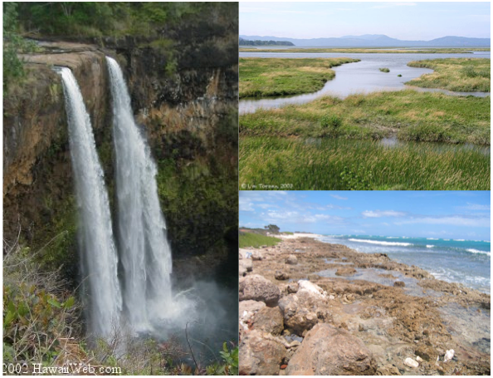
Fig. 2.11. (A) Wailua Falls, Kaua‘i, Hawai‘i (B) Columbia River estuary, Oregon (C) Barber’s Point tidepools, O‘ahu, Hawai‘i

Slide 7
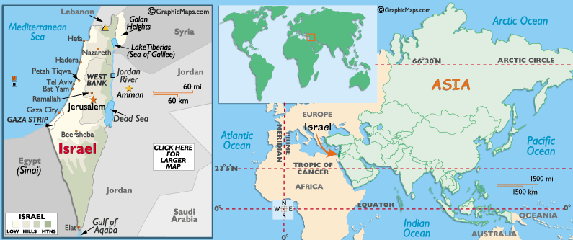
Weird Science: Salty Lakes
One of the world’s saltiest lakes, the Dead Sea, is 280 ppt or 28% salt!
Located between Jordan and Israel

Slide 8
Weird Science: Salty Lakes
Area gets very little rain and is very hot
Water evaporates due to the heat and lack of rain → salts are left behind

Slide 9
Weird Science: Salty Lakes
Only a certain amount of salt can dissolve in water
The Dead Sea is so salty that salt precipitates out of the water and piles up at the bottom of the lake
White crystallized salt covers everything along the shores

Slide 10
Weird Science: Salty Lakes
This environment is too salty for most organisms
Only specially adapted bacteria and fungi have been found living in the Dead Sea

Slide 11
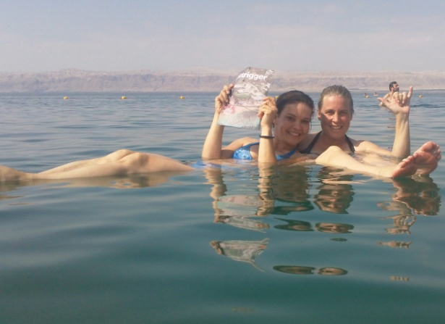
Weird Science: Salty Lakes
The Dead Sea is so dense that it is hard to swim because people are so buoyant
Most people who swim on their backs in the Dead Sea look like they are reclining on underwater chairs
Courtesy of Christina Roeschel and Valerie Blaisdell Presdee
SF. Fig. 2.3. Catching up on the news in the Dead Sea. Try doing this in the ocean or a fresh water lake!

Slide 12
Dead Sea Facts
Surface is >1,300 feet below sea level.
The deepest part is >2,300 feet below sea level
Down to ~130 feet
  300 g salt/kg seawater
Below 300 feet
  332 g salt/kg seawater (saturated)

Slide 13
Dead Sea Diving
Diving – divers have to carry 90 pounds (40 kilograms) of weight to decrease buoyancy
Full face masks to protect eyes and mouths
  swallowing Dead Sea salt water would cause the larynx to inflate, resulting in immediate choking and suffocation
  the intensely salty water would instantly burn and likely blind the eyes
http://news.nationalgeographic.com/news/2011/09/110928-new-life-dead-sea-bacteria-underwater-craters-science/?source=link_fb20110928news-lifeformsdeadsea#

Slide 14
Dead Sea – more information
http://www.extremescience.com/dead-sea.htm
http://news.nationalgeographic.com/news/2011/09/110928-new-life-dead-sea-bacteria-underwater-craters-science/?source=link_fb20110928news-lifeformsdeadsea#

Slide 15
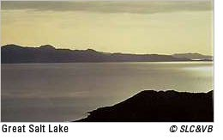
Great Salt Lake
In Utah
Largest natural lake west of the Mississippi River
Salty because it does not have an outlet
Remnant of Lake Bonneville; a great ice age lake that rose from a small saline lake 30,000 years ago
http://www.utah.com/stateparks/great_salt_lake_facts.htm

Slide 16
Great Salt Lake (Utah)
Too saline to support fish and most other aquatic species
  Some algae lives in the lake
  Brine shrimp and brine flies eat the algae
  Brine shrimp eggs are harvested commercially and are sold overseas as prawn food
Bridger Bay – place to float on the lake
http://www.utah.com/stateparks/great_salt_lake_facts.htm

Slide 17
The “Science” Behind Pruney Fingers
Pruney fingers grip better: Theory suggests wrinkling of wet digits evolved for a reason
  Ed Yong
  http://www.nature.com/news/2011/110628/full/news.2011.388.html

Slide 18
Measuring Salinity
Both temperature and salinity affect density
The more minerals dissolved in each mililiter (mL) of water, the greater the density of the water
If density and temperature of a given water sample are know, salinity can be determined from a graph (Fig. 2.13)

Slide 19
Measuring Salinity
When salinity is not known, one of the most common methods for determining the salinity of a solution is to:
  Measure the density of the solution.
  Convert the density measurement to salinity.
A hydrometer can be used to measure density if the temperature of the sample is known.
video

Slide 20
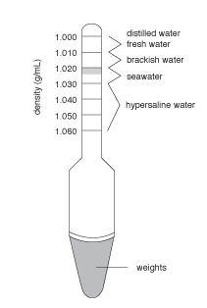
Measuring Salinity - Hydrometers
A hydrometer is an instrument that measures the density of a solution by floating in a liquid
  The higher the density of the liquid
    the higher the hydrometer will float
    the higher the scale will stick out of the water
  The density line of the hydrometer is read at the surface of the liquid
Fig. 2.12. An aquarium hydrometer showing the density range of water samples in g/mL

Slide 21
Measuring Salinity - Hydrometers
Hydrometer calibrated for a range of densities
  1.000 distilled water
  1.000-1.010 fresh water
  1.010- <1.033 brackish water
  1.033-1.038 seawater
  >1.038 hypersaline (brine))

Slide 22
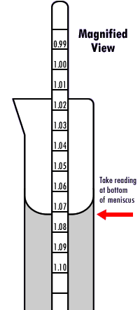
Reading a Hydrometer
Lower hydrometer into solution carefully (do not drop or it may break because it is glass)
Read at the bottom of the meniscus
video

Slide 23
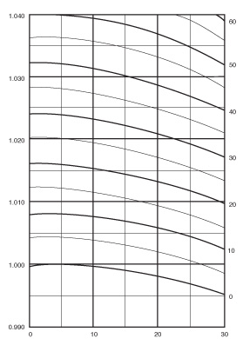
Fig. 2.13 Relationships between temperature, density, and salinity
Temperature
  Horizontal (x)
Density
  Vertical (y)
Salinity
  curved
Density (g/mL)
Salinity (ppt)
Temperature (°C)

Slide 24
Other ways to measure salinity
http://www.sciencelearn.org.nz/Contexts/Icy-Ecosystems/Sci-Media/Video/Measuring-salinity

Slide 25
Conductivity
Conductivity is a measure of a solution’s ability to conduct electricity
Electricity needs charged particles in order to flow
Generally, the more ions in a solution, the better the solution can conduct electricity

Slide 26
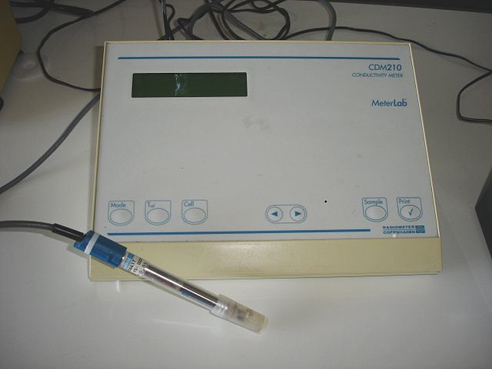
Conductivity meter
Used by scientists to determine the salinity of sea water
Salinity refers to the amount of dissolved salts in a solution
Salts are ionic compounds = can be broken down into positive and negative ions

Slide 27
Other uses for conductivity meters
Used in industry to measure ionic content in:
  Public water supplies
  Hospitals
  Breweries

Slide 28
Non-ion specific
Conductivity is non-ion specific so you can use it to estimate the total amount of dissolved ions (or dissolved solids)
NaCl is the primary salt in seawater
  It dissolves into Na⁺ and Cl⁻ ions in water
  The more ions there are, the higher the conductivity

Slide 29
FE 2-3X Conductivity Activity
Glue the four activity sheets into your SNB (pages 1-4) on facing pages
No prelab for procedures required
Finish all parts TODAY!
1 2
3 4

Slide 30
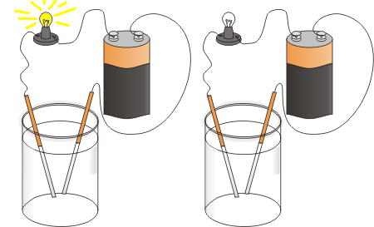
Simple conductivity meter

Slide 31
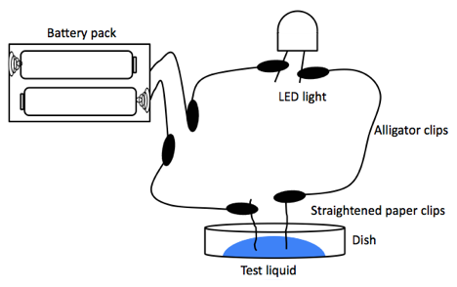
Figure 2.3 Simple Conductivity Meter

